Slide 1
Welcome and keynote: correlation versus causation
Dr Eliza Kozman (Deputy Director, Research)
April 2021

Slide 2
Who we are
Independent hub for higher education professionals to access research, toolkits, evaluation techniques and more to help widen participation and improve equality within the sector.
An independent charity, set up by a consortium of King’s College London, Nottingham Trent University and the Behavioural Insights Team.
An affiliate What Works Centre, and part of the UK Government’s What Works Movement.
Funded by the Office for Students from 2019 to 2023.

Slide 3
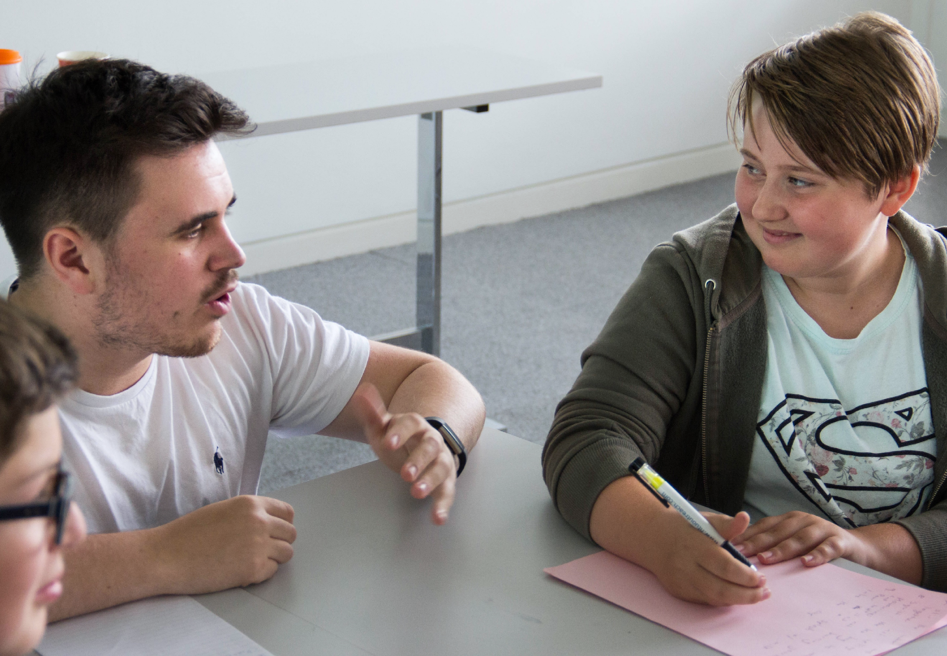
Our vision and mission
Our vision is to eliminate equality gaps in higher education.
Our mission is to improve lives through evidence-informed practice in higher education.

Slide 4
Correlation versus causation

Slide 5
What we really want to know
What are the best ways addressing inequality in access and success?

Slide 6
The missing type of evidence
“Most of the studies analysed found positive but modest effects. There are still some gaps in the research base, and the evidence often does not demonstrate causality…”
See: https://taso.org.uk/publications/

Slide 7
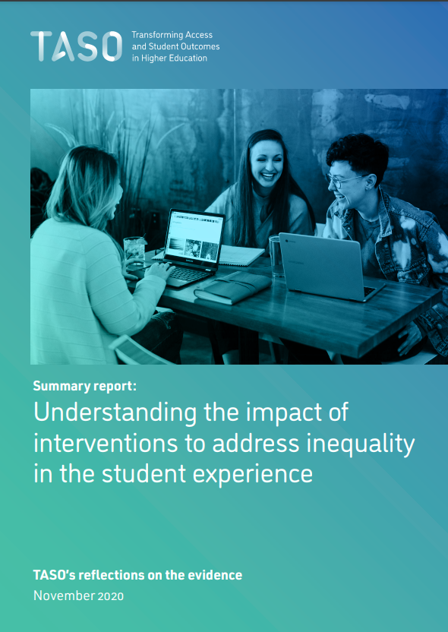
The missing type of evidence
“There are still some gaps in the research base, and the evidence often does not demonstrate causality…”
See: https://taso.org.uk/publications/

Slide 8
The missing type of evidence
“However, small sample sizes and gaps in data coverage hinder the development of robust causal studies…”
See: https://taso.org.uk/publications/

Slide 9
But what does it mean?
Causality
Causal evidence
?
Causal attribution
Causal inference

Slide 10
Correlation

Slide 11
A definition
Correlation means there is a relationship between two variables
Variable A and Variable B are related somehow
A B

Slide 12
Types of correlation
A
B
From: https://www.mathsisfun.com/data/correlation.html

Slide 13
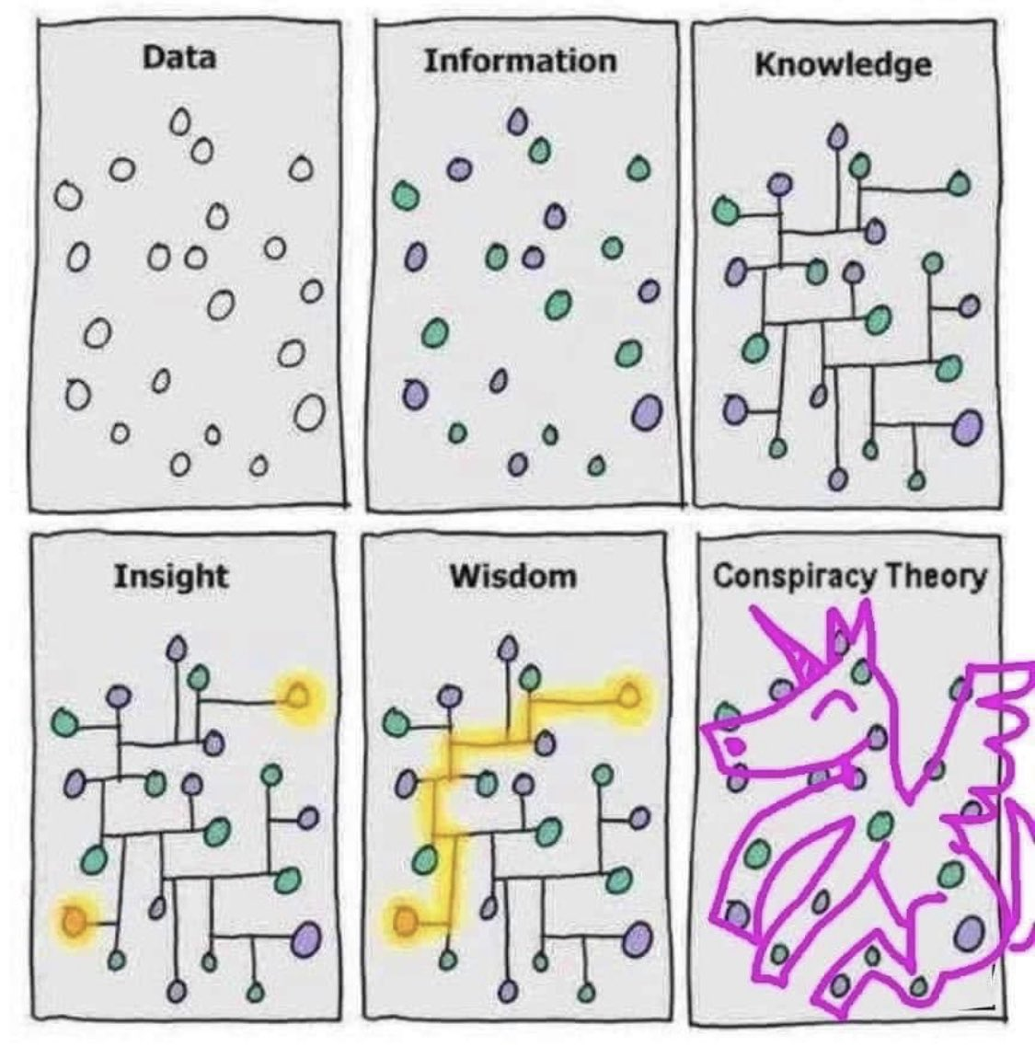
Be careful!
Our brains LOVE to find and explain patterns, particularly when they support our beliefs!

Slide 14
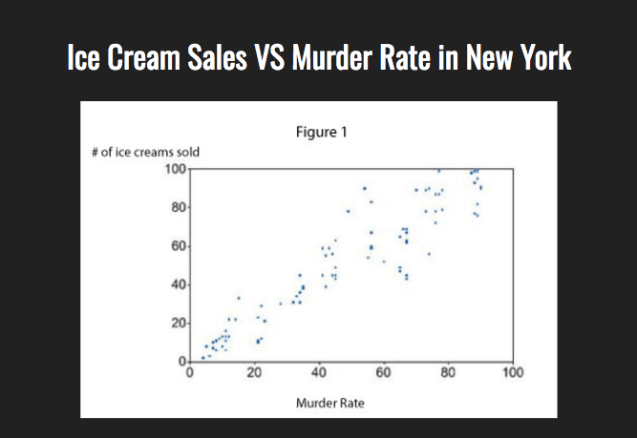
Example: the dangers of ice cream
From: https://www.lifehack.org/624604/the-most-common-bias-people-have-that-leads-to-wrong-decisions

Slide 15
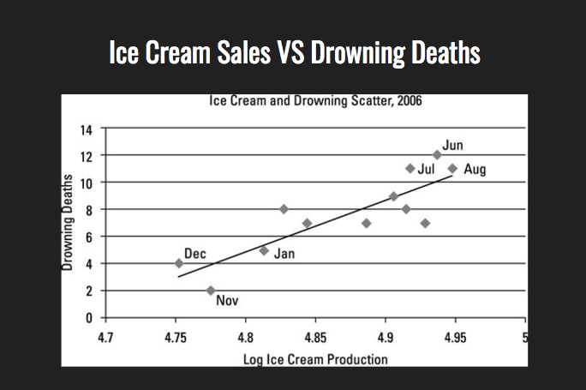
Example: the dangers of ice cream
From: https://www.lifehack.org/624604/the-most-common-bias-people-have-that-leads-to-wrong-decisions

Slide 16
The dangers of ice cream
DANGER: Ice cream
linked to murder and drowning

Slide 17
The dangers of ice cream
DANGER: Ice cream CAUSES murder and drowning?

Slide 18
Assessing a ‘causal’ claim
Coincidence
Reverse causation
Confounders
Adapted from https://alliancefordecisioneducation.org

Slide 19
Coincidence

Slide 20
Coincidental correlation
From: www.tylervigen.com

Slide 21
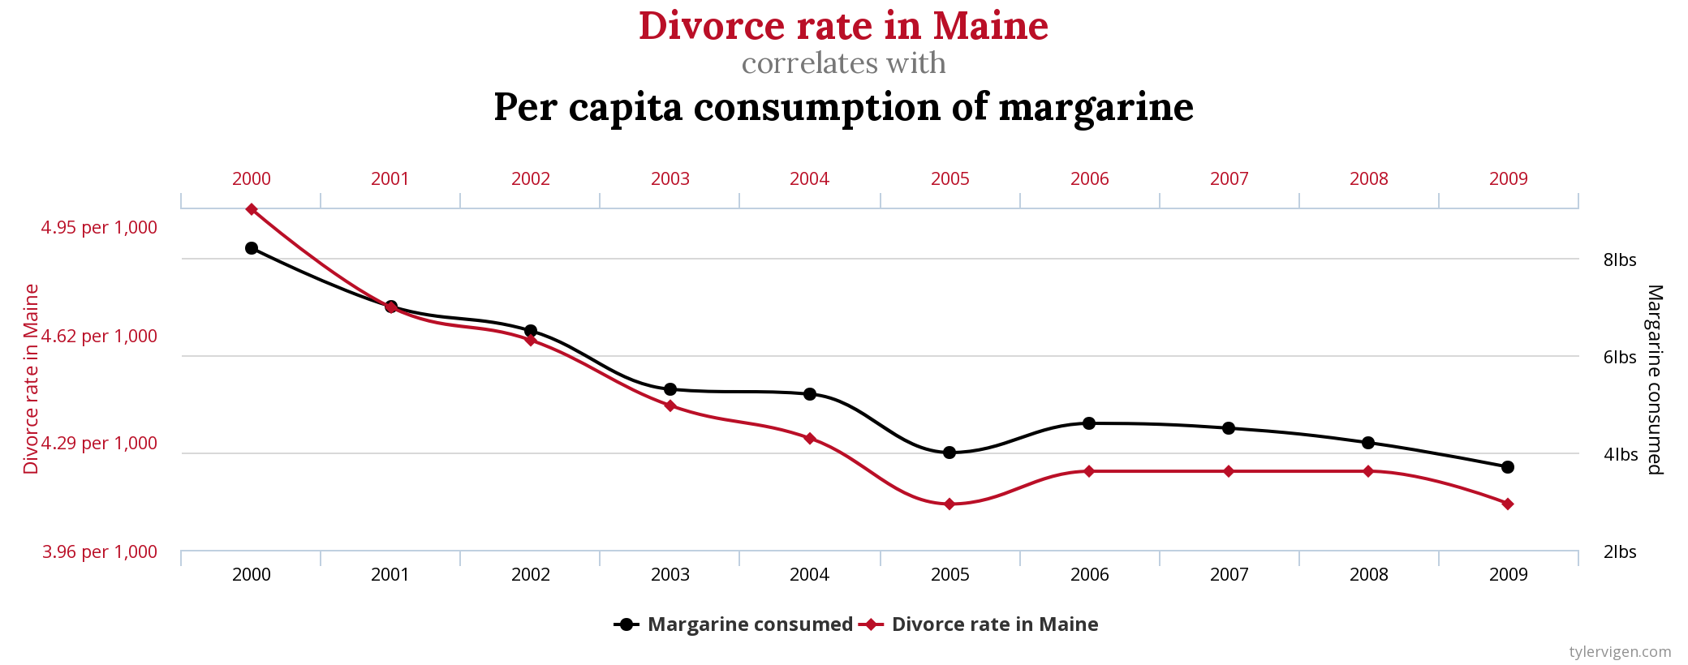
Coincidental correlation
From: www.tylervigen.com

Slide 22
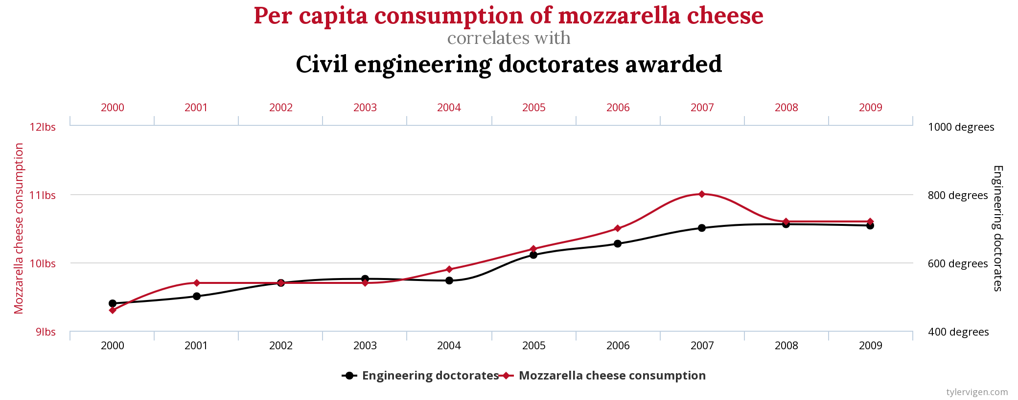
Coincidental correlation
From: www.tylervigen.com

Slide 23
Causation checklist
Coincidence
Maybe…
DANGER: Ice cream linked to murder and drowning
Reverse causation
Confounders

Slide 24
Reverse causation

Slide 25
Reverse causation
A B

Slide 26
Reverse causation
A B

Slide 27
Reverse causation
Winter coat usage Cold weather
Wind blowing Windmill turning

Slide 28
Causation checklist
Coincidence
Maybe…
DANGER: Ice cream linked to murder and drowning
Reverse causation
Unlikely
Confounders

Slide 29
Confounders

Slide 30
Confounders
Something else is causing both A and B to change
‘Something else’
A B

Slide 31
Confound it all!
Ice cream sales Murder Drowning

Slide 32
Confound it all!
Sunshine
Going outside
Swimming
Ice cream sales Murder Drowning

Slide 33
Causation checklist
Coincidence
Rule this out
DANGER: Ice cream linked to murder and drowning
CANCEL THE ICE CREAM BAN
Reverse causation
Unlikely
Confounders
Hot weather!

Slide 34
Causation checklist
Coincidence
The pattern is just a fluke
Before we make an unreserved causal claim, we need to rule out these options…
Reverse causation
There is a link between A and B but instead of A causing B, B is causing A.
Confounders
Some other factor (a ‘confounding variable’) is influencing both A and B.

Slide 35
Some examples

Slide 36
Causation checklist: tutoring
“Students with a tutor have poorer grades than those without a tutor”
Adapted from https://alliancefordecisioneducation.org

Slide 37
Causation checklist: tutoring
Coincidence
The pattern is just a fluke
Does having a tutor CAUSE lower grades?
Reverse causation
There is a link between A and B
Instead of A causing B, B is causing A.
Tutor Lower grades
Confounders
Some other factor (a ‘confounding variable’) is influencing both A and B.

Slide 38
Causation checklist: outreach
“Participation in outreach is associated with higher HE attendance”

Slide 39
Causation checklist: outreach
Coincidence
The pattern is just a fluke
Does outreach CAUSE higher HE attendance?
Student motivation, school support
Reverse causation
There is a link between A and B
Instead of A causing B, B is causing A.
Outreach HE attendance
Confounders
Some other factor (a ‘confounding variable’) is influencing both A and B.

Slide 40
Causation checklist: outreach
See: www.taso.org.uk/wp-content/uploads/relationship-outreach-attainment-progression.pdf

Slide 41
Causation checklist: books
“The more books in a household, the stronger the academic performance of the children in the family”
Adapted from https://alliancefordecisioneducation.org

Slide 42
Causation checklist: books
Coincidence
The pattern is just a fluke
Do books CAUSE higher grades?
Parents place greater value on learning and offer more support
Reverse causation
There is a link between A and B
Instead of A causing B, B is causing A.
Books Grades
Confounders
Some other factor (a ‘confounding variable’) is influencing both A and B.

Slide 43
What we really want to know
What are the best ways addressing inequality in access and success?

Slide 44
Why this matters
Books Grades

Slide 45
Why this matters
Change number of books...
Books Grades

Slide 46
Why this matters
Change number of books... doesn’t change what really matters…
Parents place greater value on learning and offer more support
Books Grades

Slide 47
Why this matters
We might miss the real cause of any positive or negative effects, or we might get a partial picture
This makes it hard to identify the most effective approaches to supporting learners

Slide 48
So what can we do?
Choose research and evaluation methods which allow us to address the issue of causality

Slide 49
Looks straightforward
A B

Slide 50
Of course, it can be very complex...
A
B
…and there are different ways of understanding causality …but that’s another presentation…

Slide 51
Why care?
You can have a good evaluation without exploring causality
But you need to consider causation to discuss IMPACT
We are all motivated by having the biggest possible impact on equality gaps
Let’s explore how different methods can help us do that

Slide 52
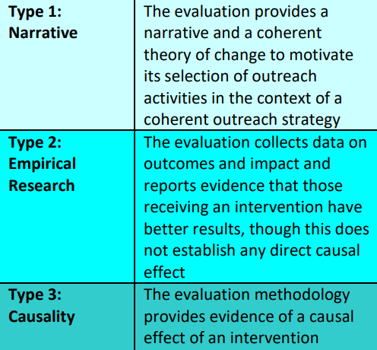
The missing type of evidence
We’ve got quite a lot of this
Some of this, and getting better
Missing piece of the puzzle

Slide 53
So how can we develop causal evidence?
Presentations today include…
Quasi-experiments
Small n evaluation
RCTs

Slide 54
This afternoon
Theory of change
Survey design and validity

Slide 55
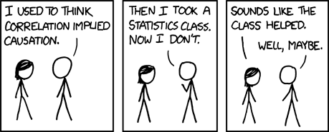
Thank you

