Slide 1
TASO Conference 2021
Survey design and validation
Rain Sherlock / Zahra Boudalaoui-Buresi
Evaluation Manager / Research Officer
Centre for Transforming Access and Student Outcomes in Higher Education (TASO)
April 2021

Slide 2
Who we are
Evaluation Manager
Research Officer
Rain Sherlock
Zahra Boudalaoui-Buresi

Slide 3
Outline of session
1
Introduction to TASO
2
What is a survey
3
Constructs and dimensionality
4
Validity
5
Reliability
6
Questions

Slide 4
Introduction to TASO
Independent hub for higher education professionals to access research, toolkits, evaluation techniques and more to help widen participation and improve equality within the sector.
An independent charity, set up by a consortium of King’s College London, Nottingham Trent University and the Behavioural Insights Team.
An affiliate What Works Centre, and part of the UK Government’s What Works Movement.
Funded by the Office for Students from 2019 to 2023.

Slide 5
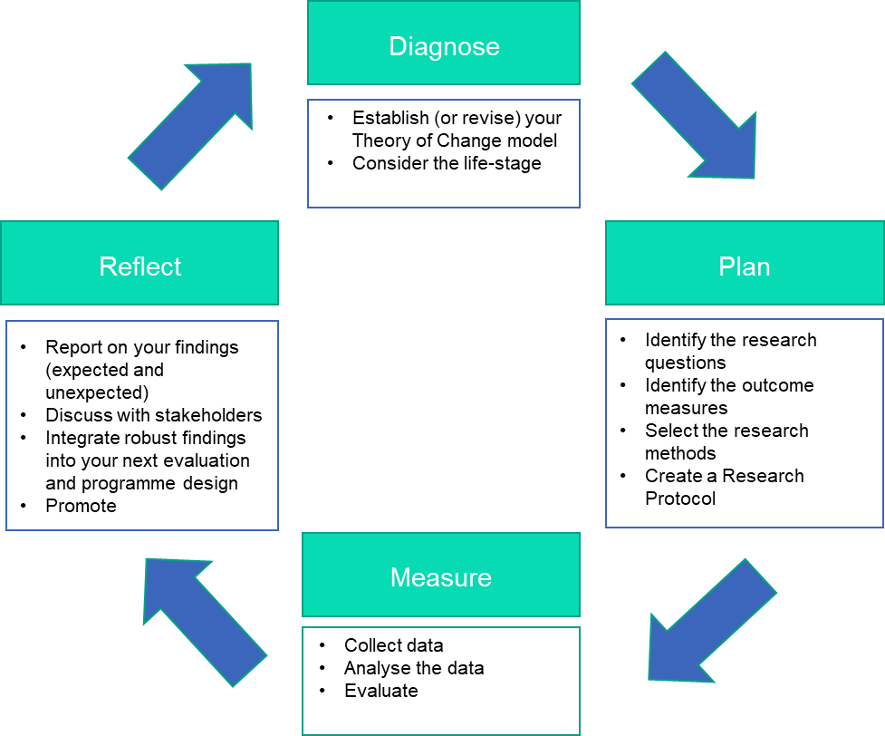
The evaluation cycle

Slide 6
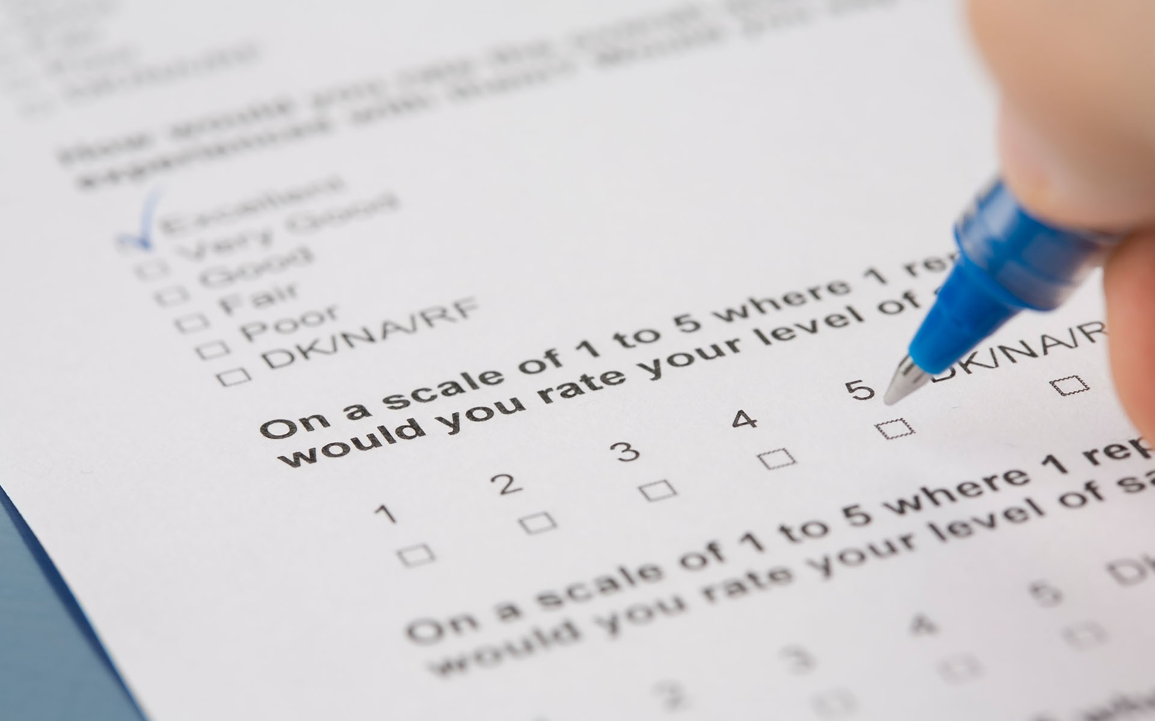
What is a survey
A data collection tool
Used to collect primary data
Self-report
Can be self-administered or conducted over the phone/face-to-face

Slide 7
How are surveys used
Commonly used method in social sciences:
The household census
Rates of unemployment
Political opinions
Increasingly used in educational research:
Assess personal attributes and attitudes
National Student Survey

Slide 8
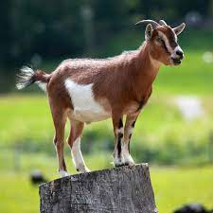
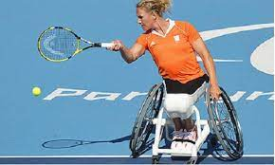
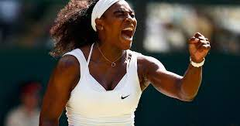
We don't always get it right
“Please rank these sport professionals according to your personal perception of their GOAT status.”

Slide 9
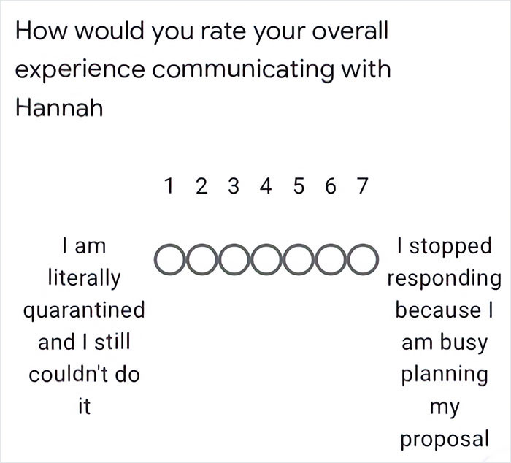
We don't always get it right
https://twitter.com/tribalspacecat/status/1240762438057725953?lang=en

Slide 10
A quick activity
Which of these examples do you think we can we reasonably represent with a single score?
Self-esteem
Depression
Job satisfaction
IQ
Personality

Slide 11
A quick activity
Can be represented with a single score
Requires multiple scores to represent it
Self-esteem
Depression
IQ
Personality
Job satisfaction

Slide 12
Measurement concepts
Construct
Indicator
Data Collection
Data

Slide 13
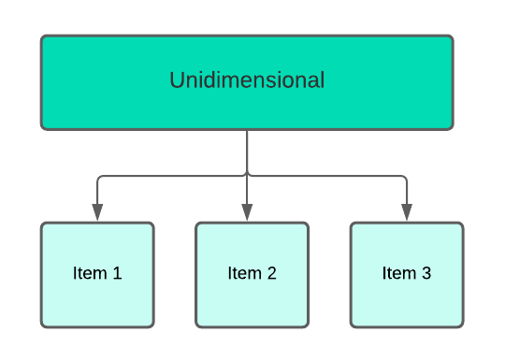
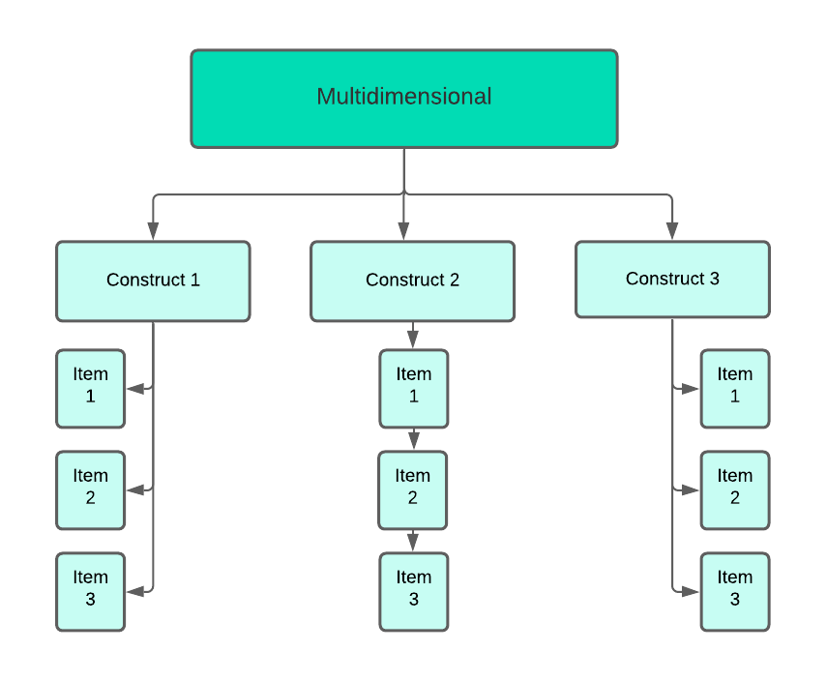
Dimensionality

Slide 14
Unidimensional scale
Rosenberg, M. (1965). Society and the adolescent self-image. Princeton, NJ: Princeton University Press.

Slide 15
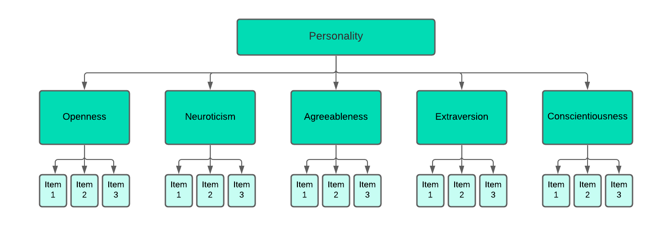
Multidimensional scale
McCrae, R. R., & Costa Jr, P. T. (2008). Empirical and theoretical status of the five-factor model of personality traits.

Slide 16
Validity
Construct
In theory: how well do indicators map to
the construct we are trying to measure?
Indicator
Data Collation
Data

Slide 17
Types of validity
Validity
Construct
validity
Content validity
Face validity
Criterion validity

Slide 18
Construct validity

Slide 19
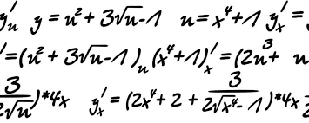
Content validity
?

Slide 20
Face validity
?

Slide 21
Criterion validity
Validity
Construct
validity
Content
validity
Face
validity
Criterion
validity
Predictive validity
Concurrent validity

Slide 22
Predictive validity
Affinity for chocolate
Chocolate consumption
Correlation

Slide 23
Reliability
Construct
Indicator
Is the indicator measured in a way
that is consistent and precise?
Data Collation
Would we get the same data
if we measured several times?
Data

Slide 24
Types of reliability
Reliability
Internal consistency
Inter-rater reliability
Test-retest reliability
Across items
Across researchers
Over time

Slide 25
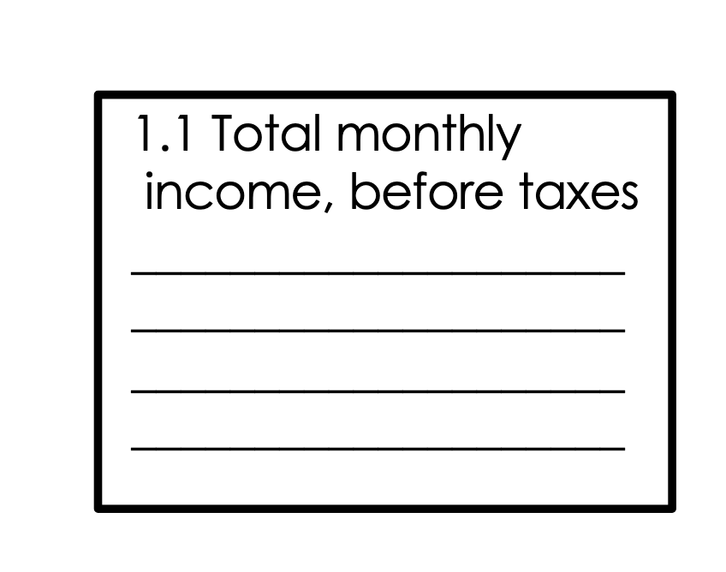
Internal consistency
I am a person of worth
I have a number of good qualities
Rosenberg Self-Esteem Scale

Slide 26
Inter-rater reliability
I have a number of good qualities
?
?
I am a person of worth

Slide 27
Test-retest reliability
Time

Slide 28
Goals of measurement
Validity
Low
High
Low
Reliability
High

Slide 29
What can we all do
01
Use pre-existing validated scales
02
Make modest changes to the wording and structure of existing scales to improve their usability in our context
Have a go at applying some of the methods discussed today – like test-retest or internal consistency
03
04
Consider developing bespoke, validated, scales specifically for the constructs we are interested in

Slide 30
Questions?

Slide 31
Evaluation guidance
Guidance on our website:
Diagnose
Plan
Measure
Reflect

Slide 32
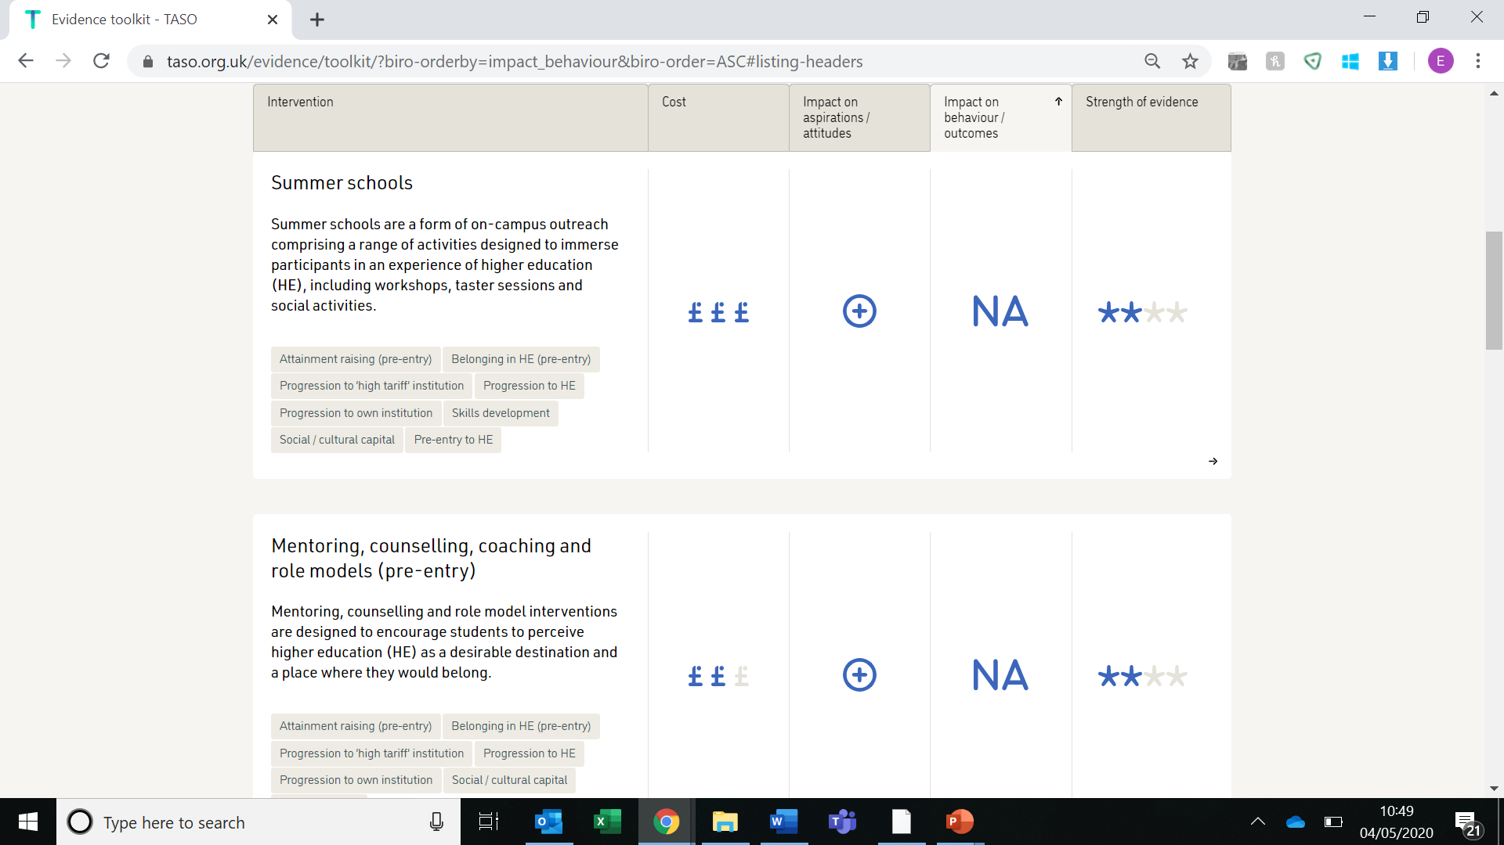
Evidence toolkit
Evidence toolkit
taso.org.uk

