Slide 1
Student Mental Health - What Does the Data Say?
Julia Ellingwood and Michael Sanders

Slide 2
Hi!

Slide 3
Partners

Slide 4
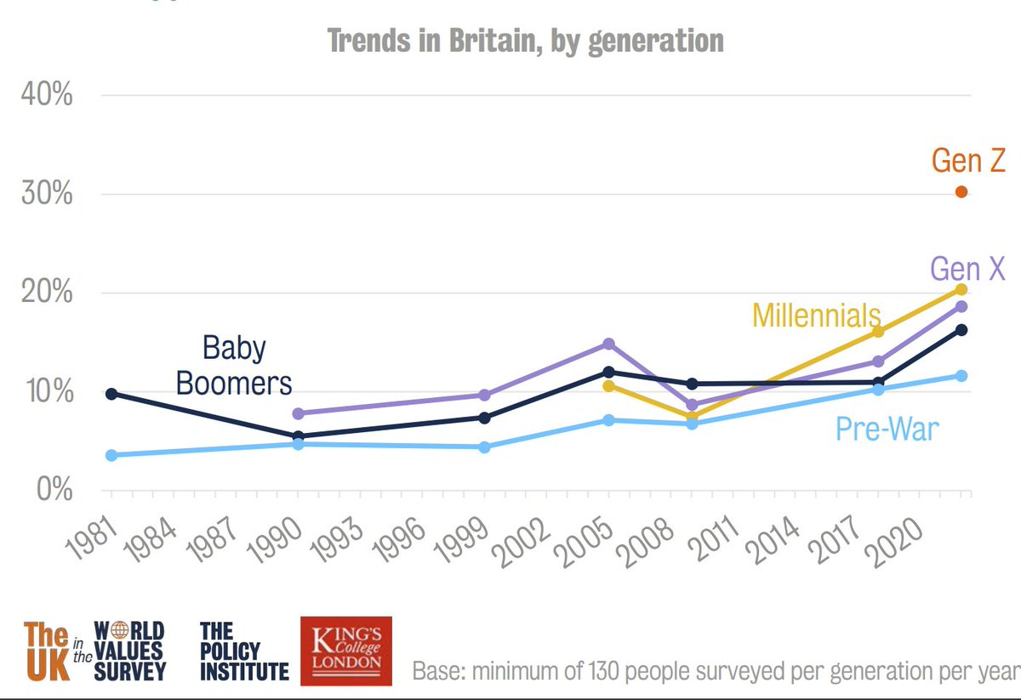
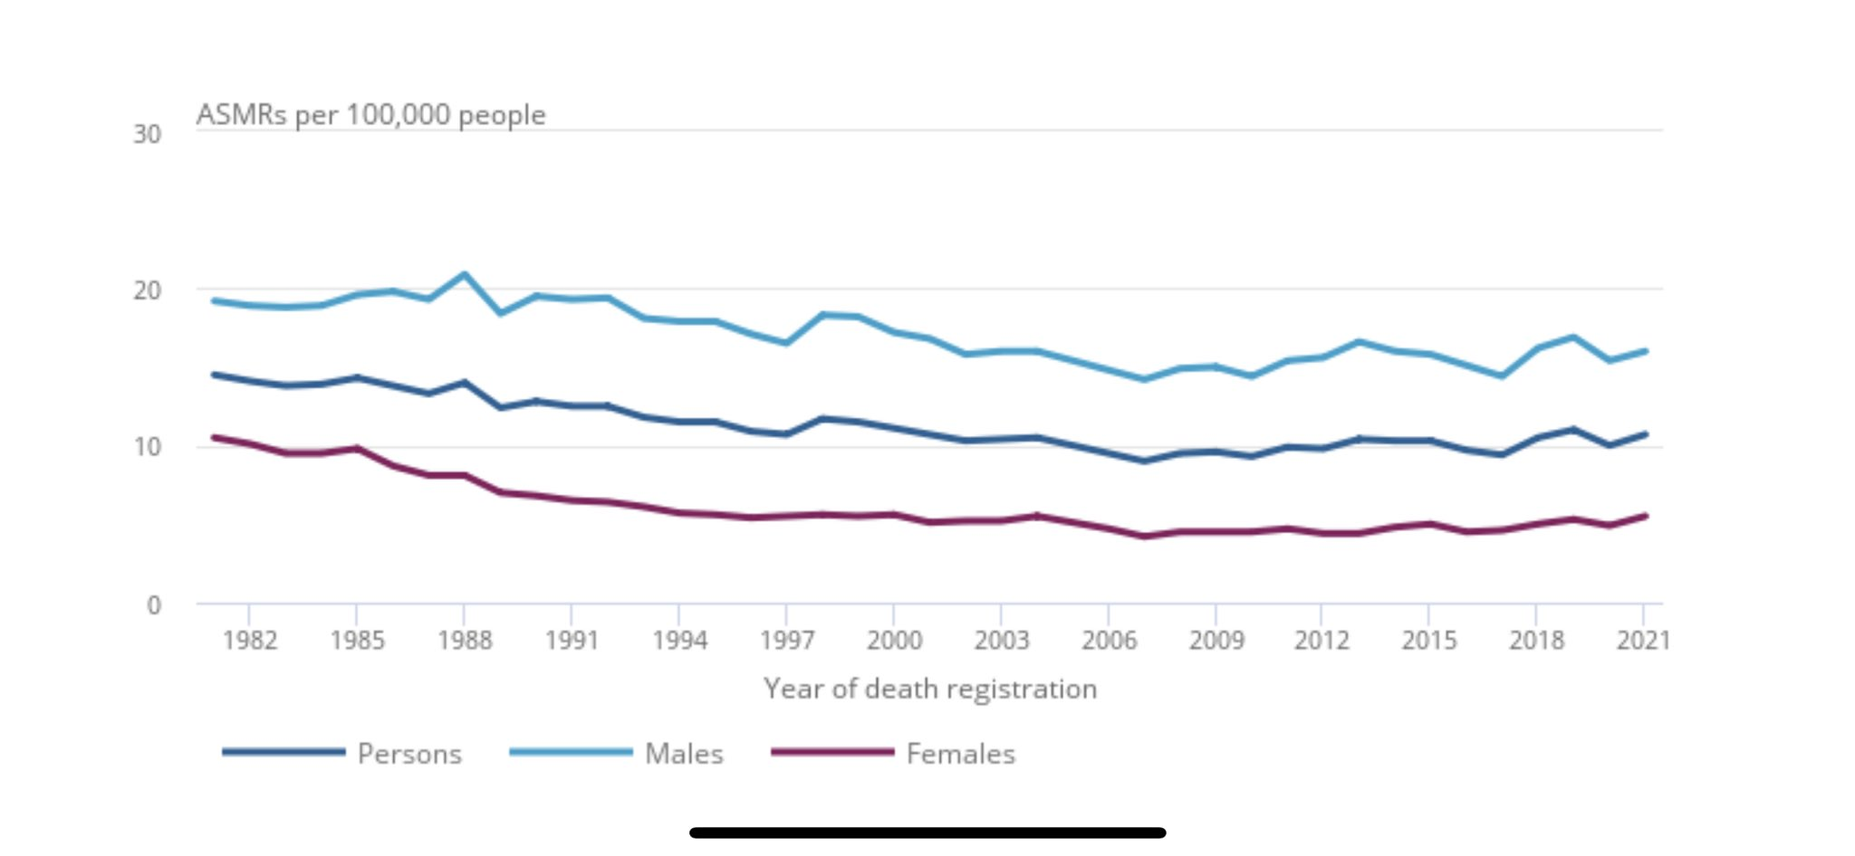
Mental Health and time
Over the last few decades, we’ve seen a gradual increase in the extent to which society is tolerant of people experiencing mental health challenges.
We have also seen a steady decline, until recently, in suicide rates. This has however, begun to reverse lately.
Notes:
ASMR = age-standardised mortality rate

Slide 5
Student mental health
We are interested in the mental health of students in particular, as poor mental health among this population presents a host of risks to life outcomes.
Large scale survey data, with consistent methodologies deployed year after year, is unusual.
We are lucky to have access to the Student Academic Experiences Survey, which surveys large numbers of full-time, undergraduate students each year, to help understand how the picture is changing.
Notes:
Risks: Not persisting to graduation, labour market entry, lifetime earnings

Slide 6
Sample - Student Academic Experience Survey (SAES)
More than 10,000 participants each year
7 waves of student mental health data
LGBA captured in all years; Q since 2019, Trans since 2021 and non-binary since 2022
This data is both unusually large, and unusually rich
Type | Category | 2017 | 2018 | 2019 | 2020 | 2021 | 2022 | 2023 | 2024
Gender identity | Man | 4516 | 4089 | 5143 | 2891 | 2876 | 3167 | 4397 | 4332
 | Woman | 9541 | 9931 | 8907 | 7279 | 7320 | 6549 | 5390 | 5736
 | Non-Binary | N/A - Not collected |  |  |  |  | 217 | 195 | 161
Sexuality | Straight | 11423 | 11265 | 11024 | 7878 | 7792 | 7697 | 8094 | 8273
 | Gay Man | 333 | 295 | 289 | 176 | 166 | 145 | 181 | 183
 | Lesbian | 243 | 238 | 221 | 173 | 192 | 224 | 213 | 217
 | Bisexual | 1147 | 1233 | 1274 | 1112 | 1109 | 1163 | 978 | 934
 | Asexual | 229 | 211 | 194 | 160 | 149 | 162 | 162 | 142
 | Queer | N/A - Not collected |  | 122 | 525 | 143 | 177 | 128 | 134
Full sample |  | 14057 | 14046 | 14072 | 10227 | 10186 | 10142 | 10163 | 10319
Notes:
Conducted by Advance HE and Higher Education Policy Institute
Weighted? Why POLAR quintile? Participation of Local Areas classification groups: Quintile one shows the lowest rate of participation. Quintile five shows the highest rate of participation.

Slide 7
What are we focusing on?
Mental health - binary, self reported.
Subjective Wellbeing, captured through 1-10 scale using ONS 4;
Happiness
Worthwhileness
Life Satisfaction
Anxiety (not clinical)
Notes:
Q: Do you have any of the following impairments or health conditions, expected to last 12 months or more? A: Mental health (e.g. depression or anxiety)
Why are we focused on these? Mental health is a clear indicator in that it meets the clinical diagnosis threshold, but wellbeing can paint a richer picture and possibly capture cases where clinical thresholds aren’t met or systematically reduced.

Slide 8
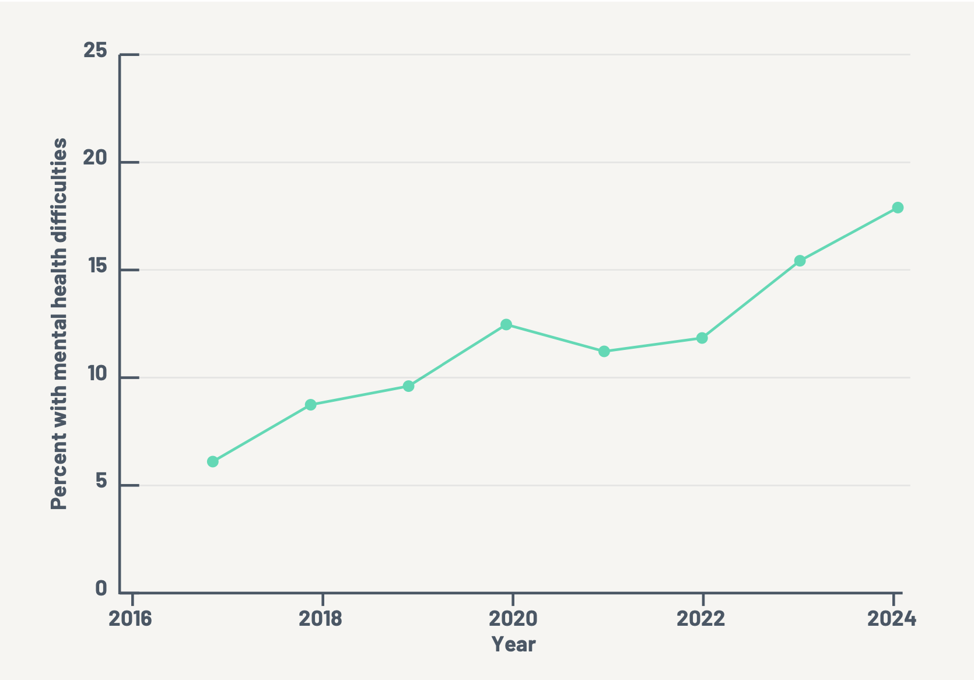
Mental Health Over time
Notes:
3x increase in mental health difficulties
Spiking in 2020, but also on the rise pre-covid, and persisting to rise all 3 years post-lockdowns. Clearly a driver, but not the whole story.
Why? Intergenerational wealth inequality? Is it phones? It’s probably phones.
Could be due to rising social awareness/acceptance/de-stigmatization of mental health difficulties, but still not a likely explanation for triple growth.

Slide 9
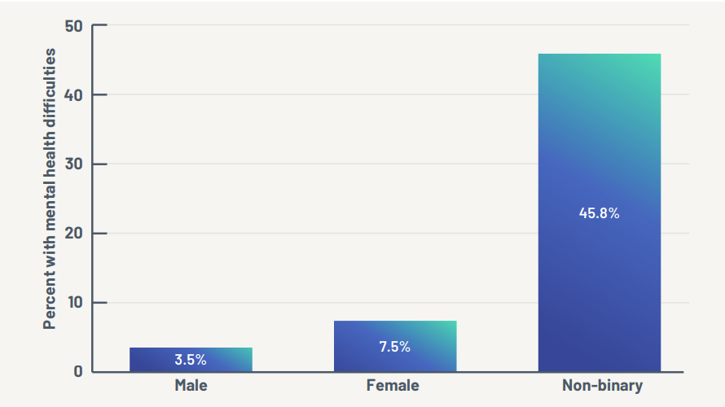
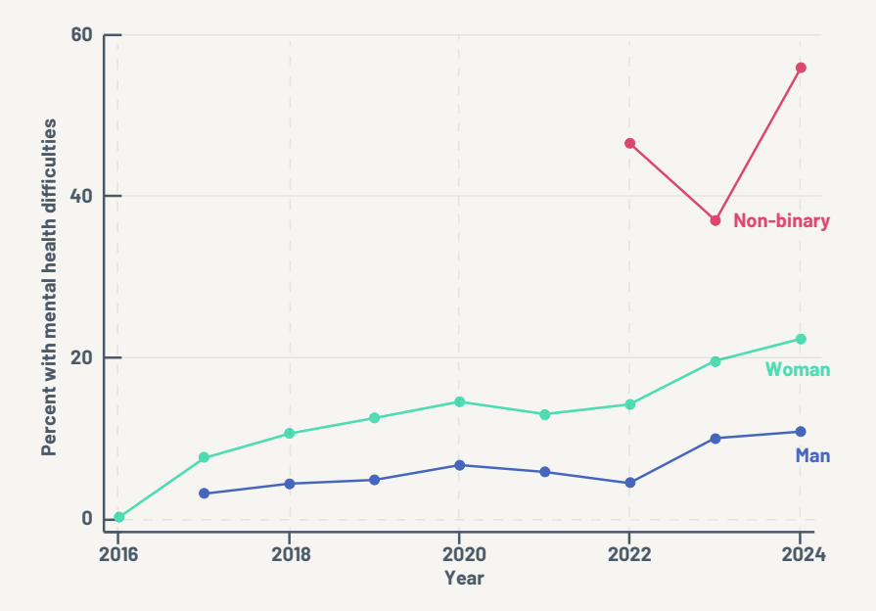
Gender Identity
Notes:
The picture gets more complex when we disaggregate by gender. Seeing a widening of outcomes between female- and male-identifying students, and a very wide gap for non-binary students (a somewhat noisier group as they only represent 1.5-2% of each wave).
Not just about suicide.

Slide 10
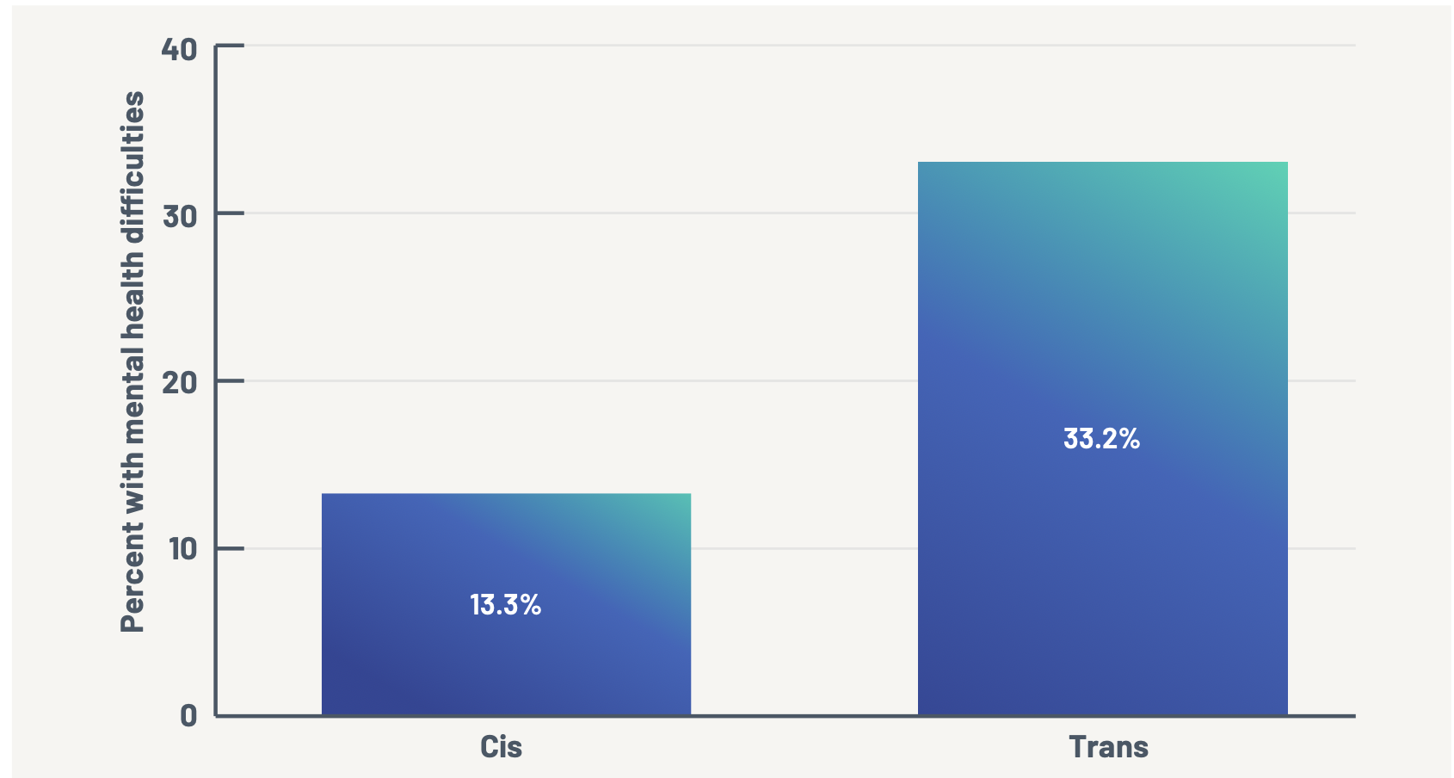
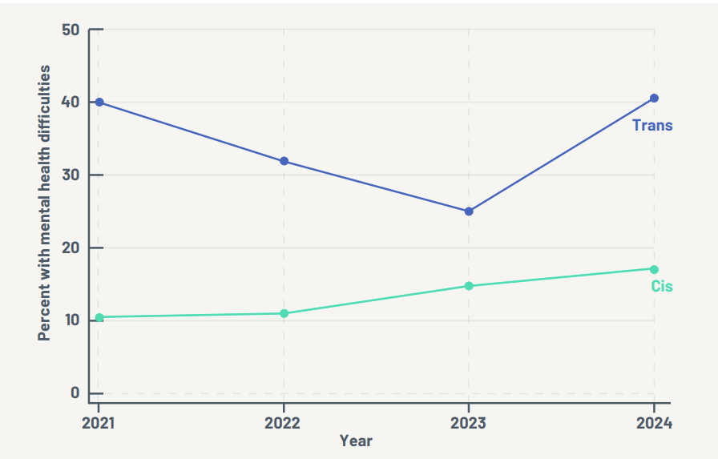
Mental Health and Cis/Trans
Notes:
Here we see the pooled average mental health across 4 years, and averages over time. We see a sizable gap between cis and trans students.

Slide 11
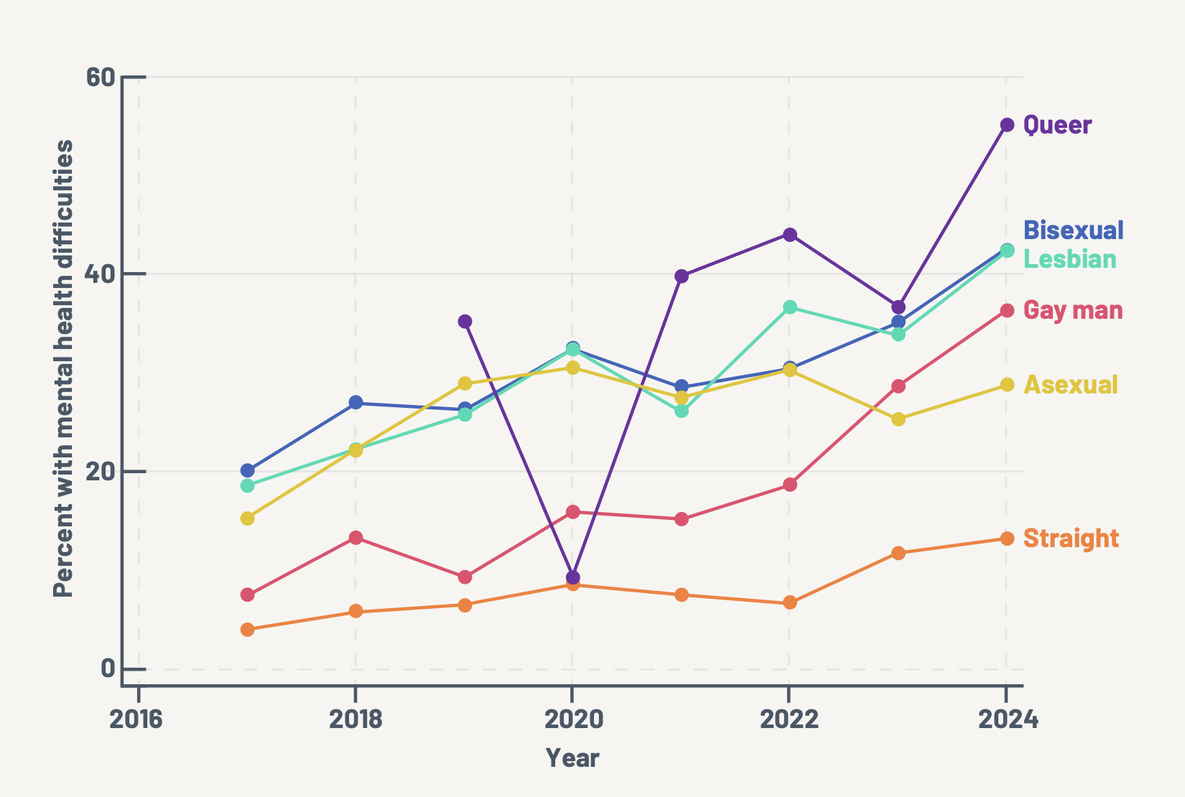
Sexuality and Mental Health over time
Notes:
LGBQA over time, since 2017. Again, increases across the board, but steeper for LGBQA students.

Slide 12
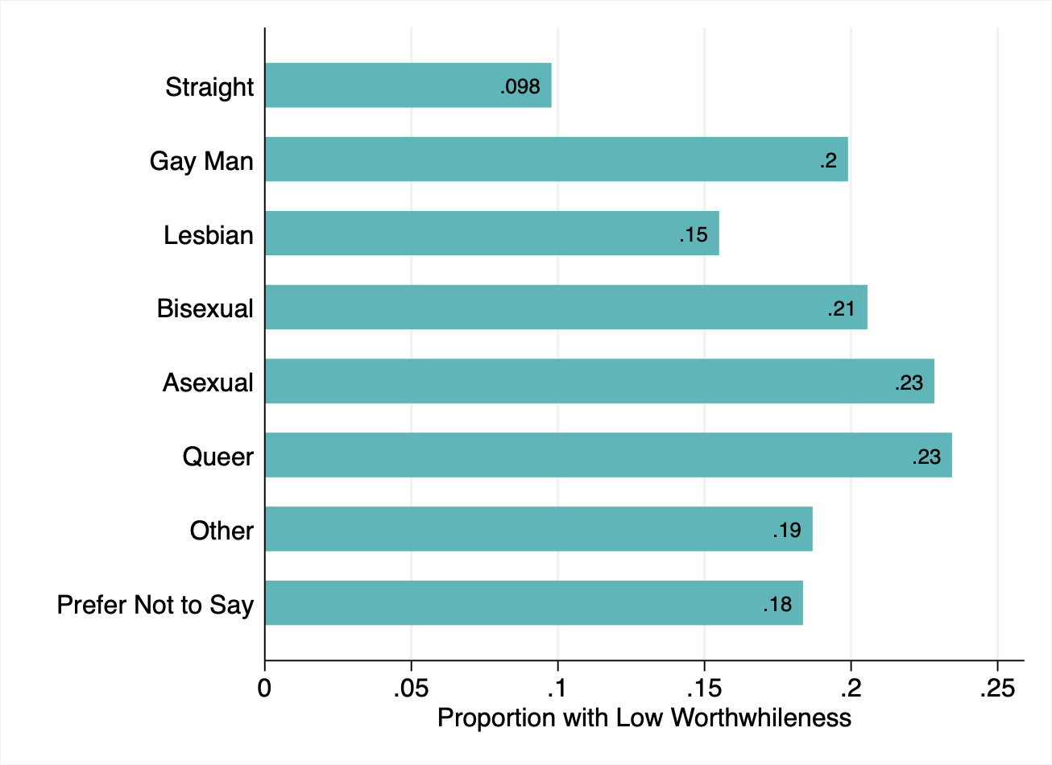
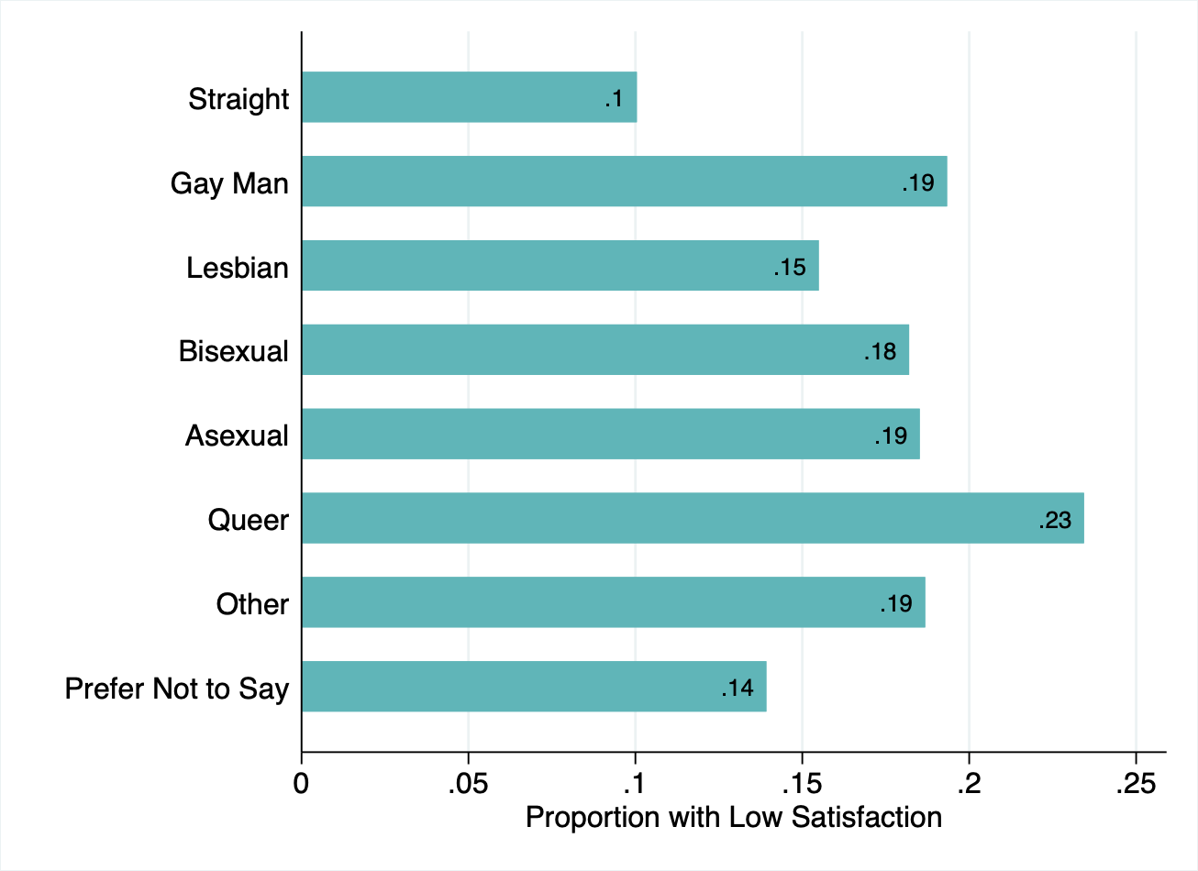
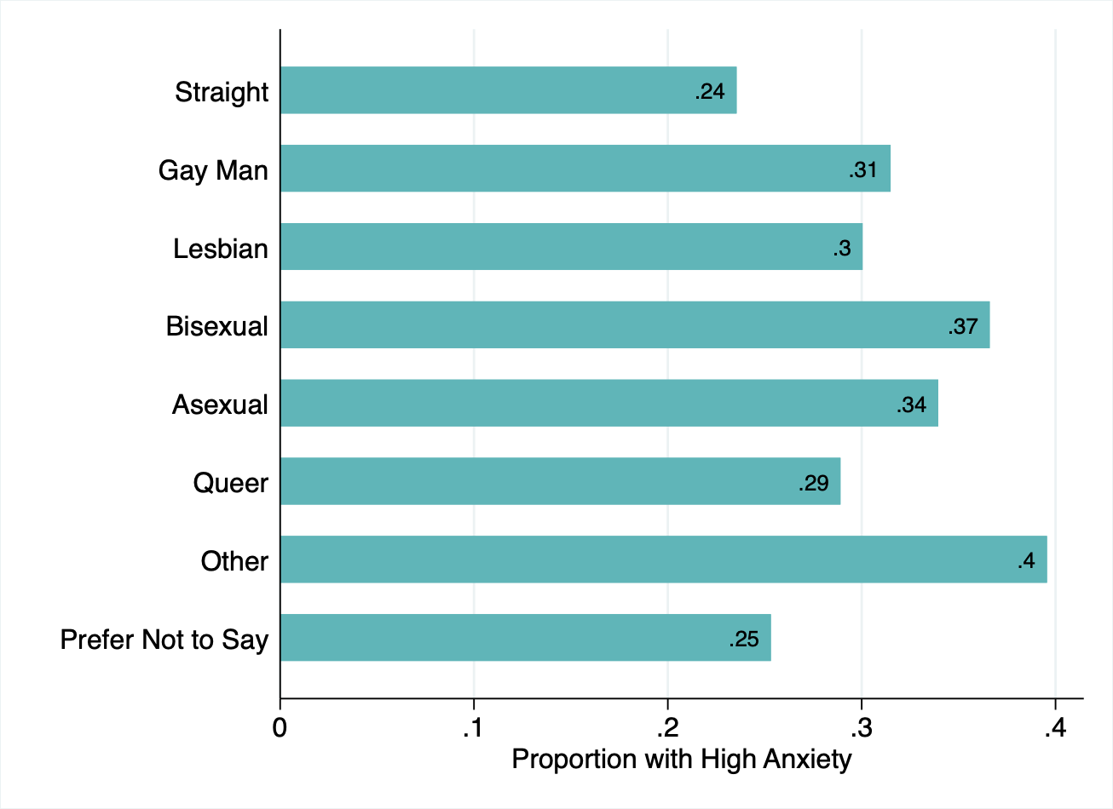
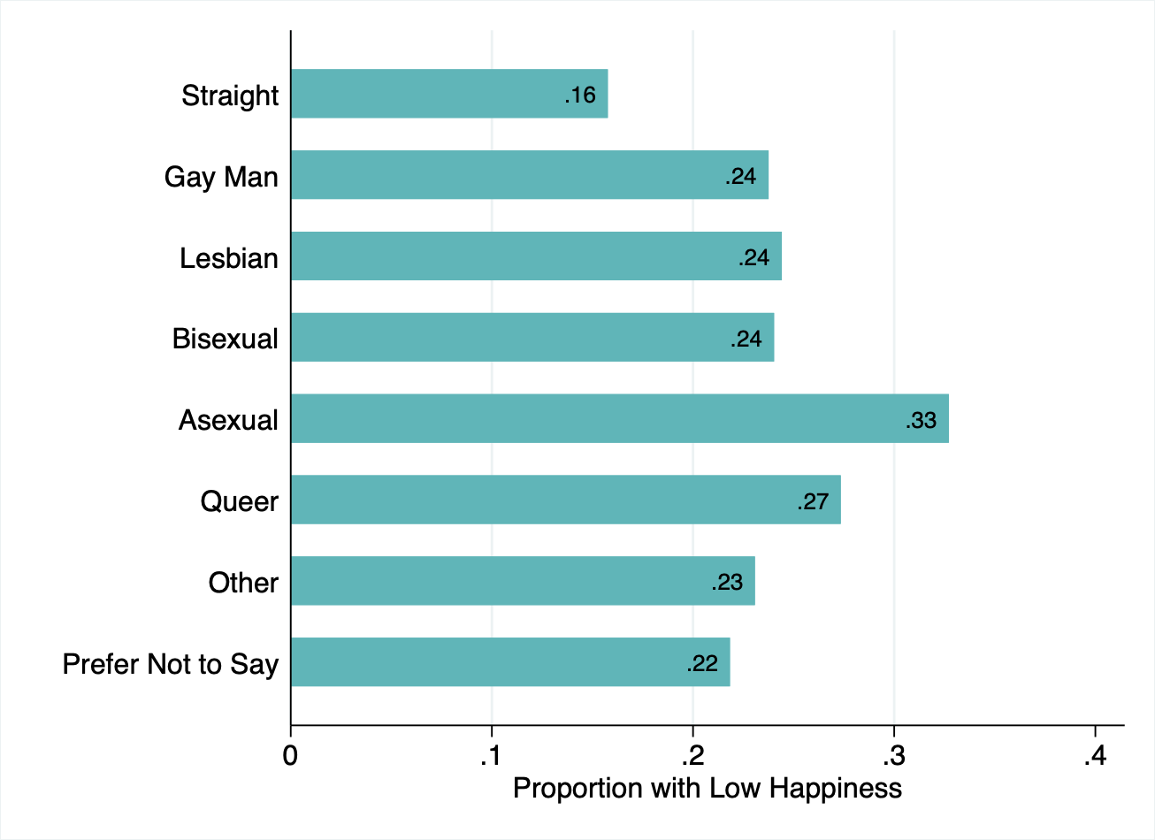
Sexuality and Wellbeing
Notes:
Not in the report, but an important perspective. Bunch of wellbeing issues that don’t clear the clinical definition of mental health difficulties.
These are the 4 ONS Qs, framed negatively (so higher rates = bad), broken down by sexuality.
Here we see Queer-identifying individuals reporting lower wellbeing across all measures except low happiness, and across the spectrum, LGBQA students are significantly more likely to report lower wellbeing compared with straight students.

Slide 13
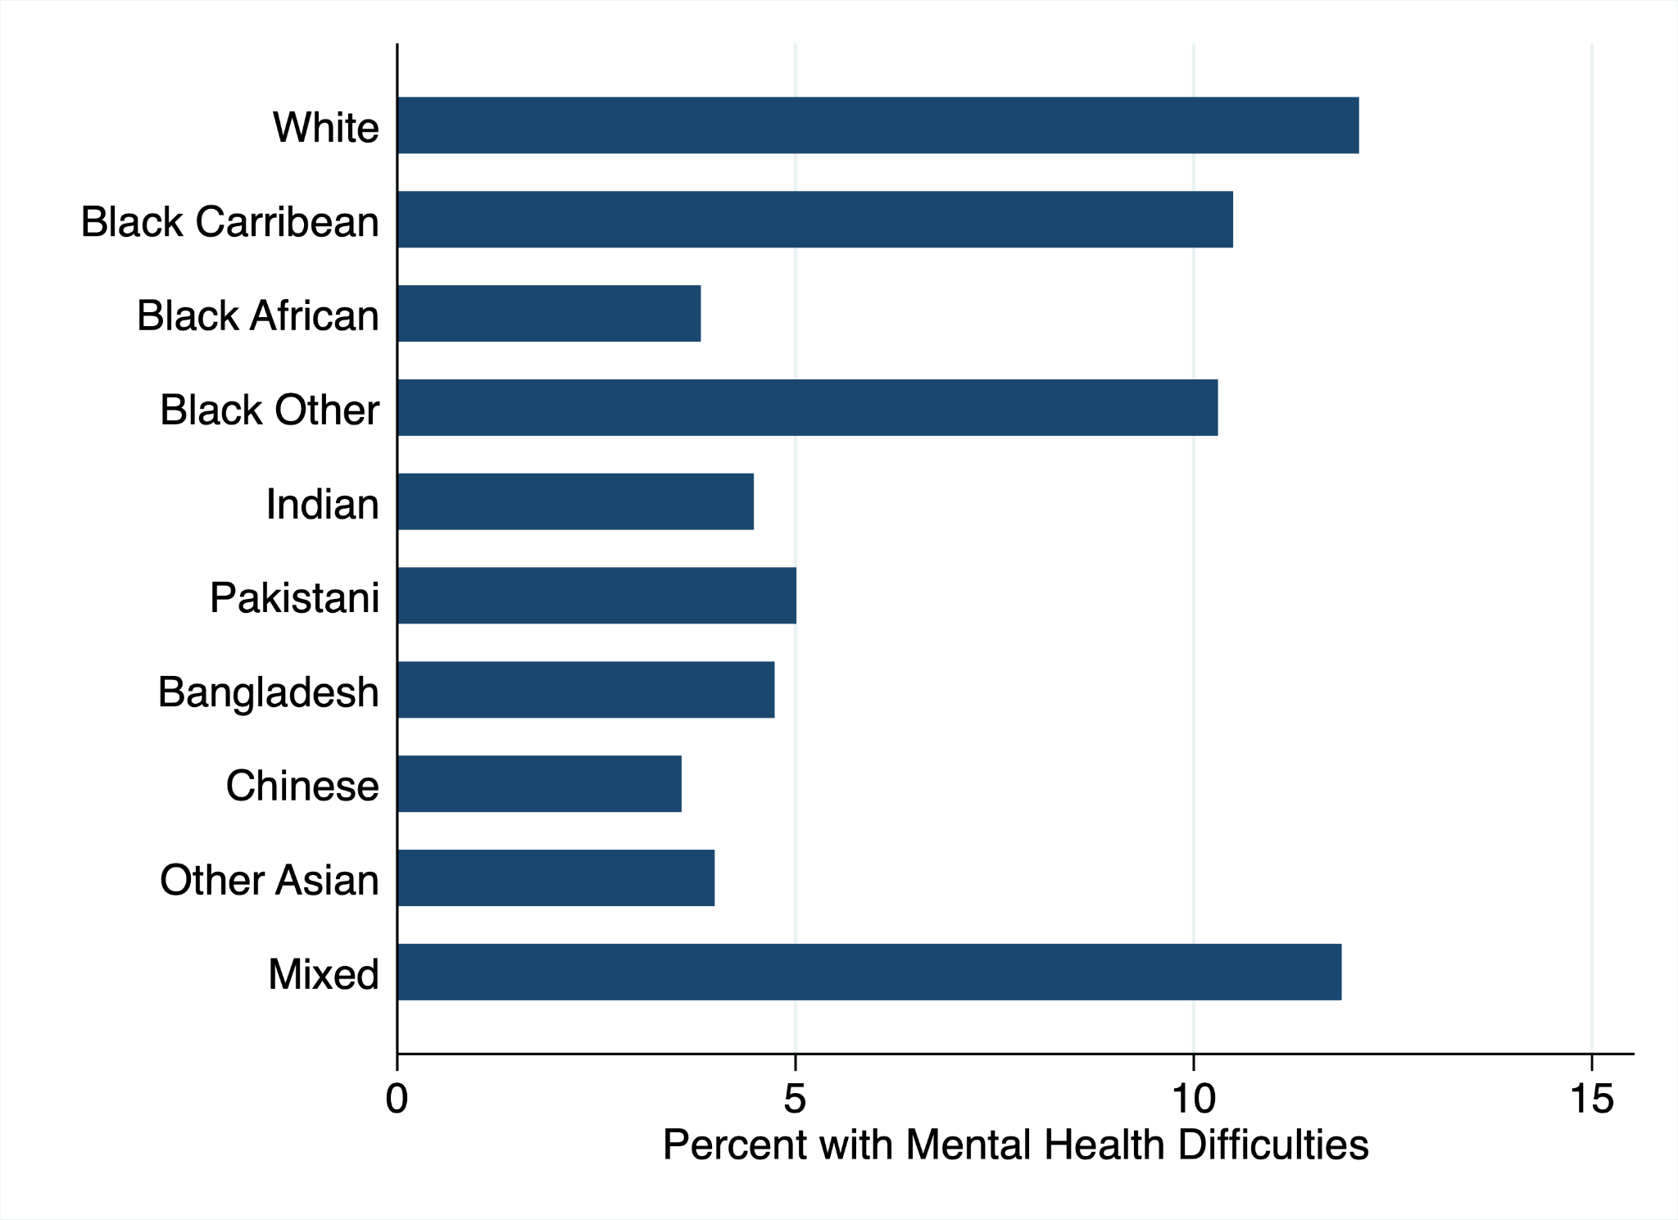
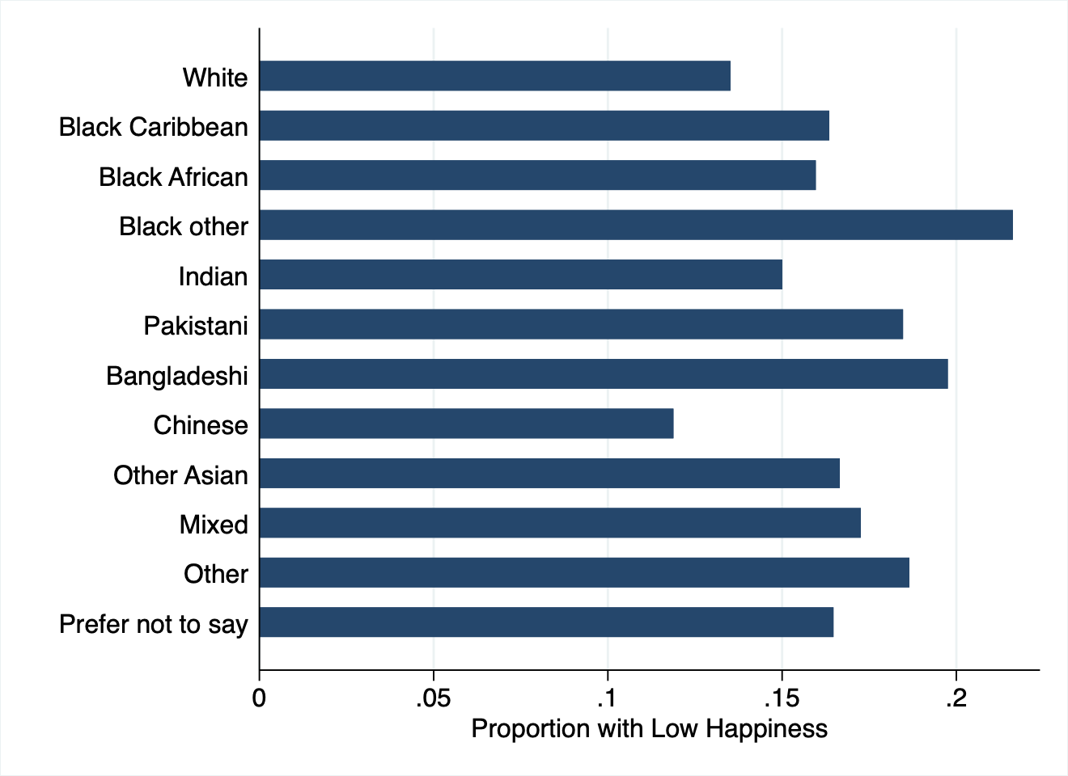
Ethnicity - a mixed picture
Notes:
This distinction between mental health difficulties and wellbeing is salient when looking at ethnicity data.
The left is in the report, which shows White and Mixed ethnicity students reporting higher overall levels of poor mental health, with all other ethnicities significantly lower with the exception of Black Caribbean and Black Other.
On the right, this is somewhat reflected in low happiness amongst Black students, but we also see that Pakistani and Bangladeshi report low happiness, while White students gravitate towards the lower end.

Slide 14
Class/Socio-Economic background
This feels qualitatively important, but is difficult to operationalise in our data.
Traditional markers, like free school meal eligibility, aren’t captured.
Asking people their social class is riven with difficulties.
There are a number of (slightly imperfect) measures that we can look at.

Slide 15
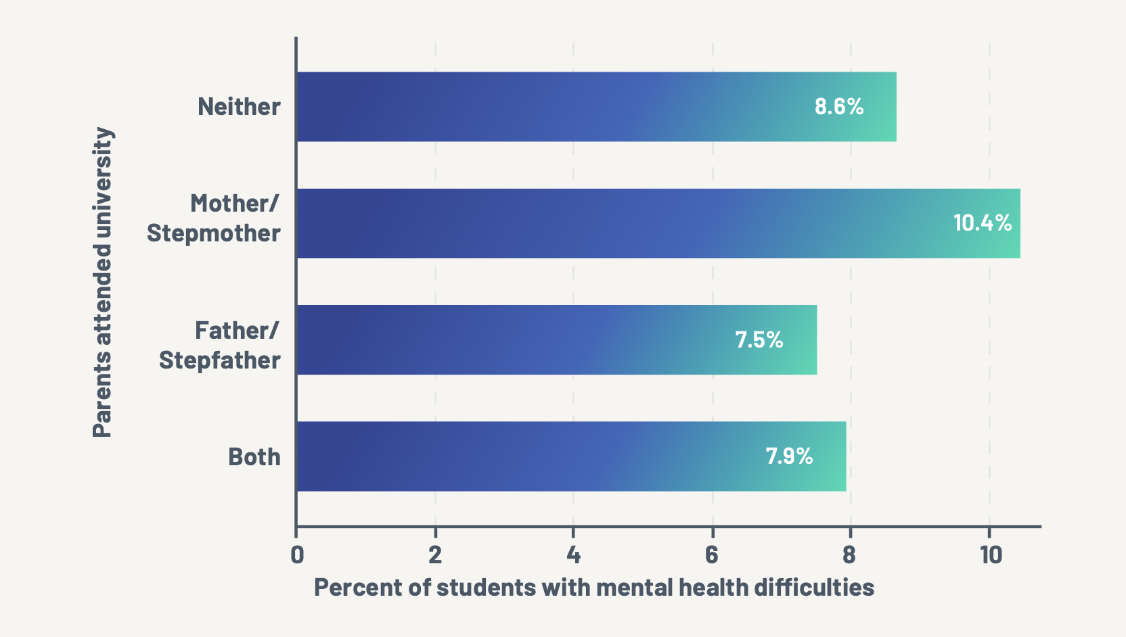
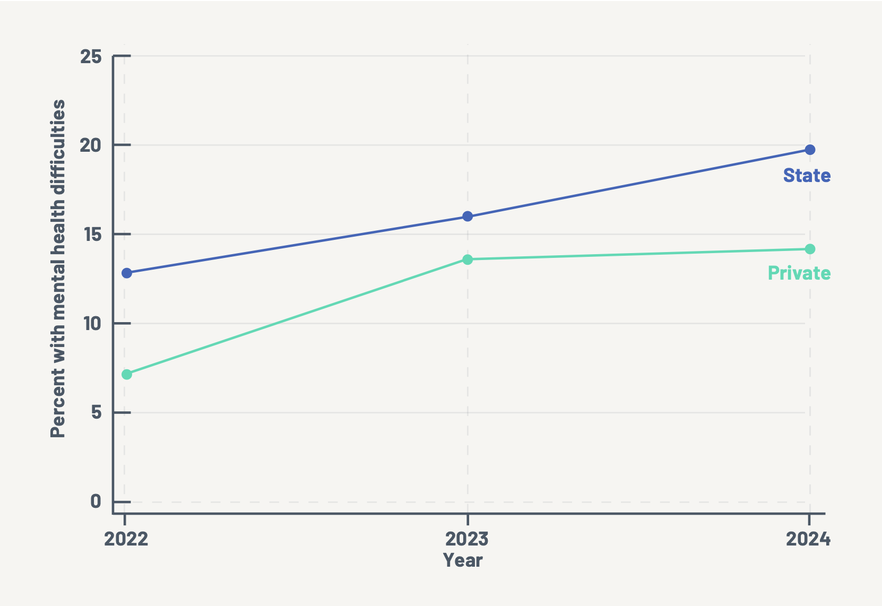
Educational and family background

Slide 16
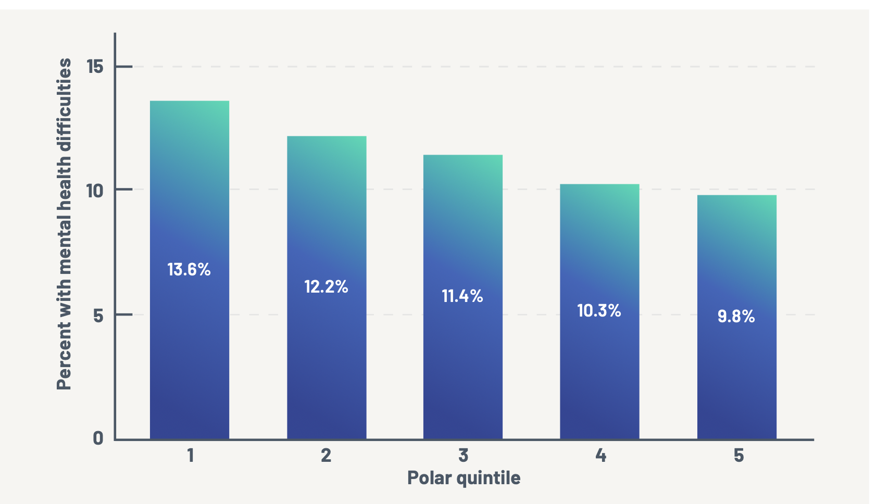
POLAR Quintile

Slide 17
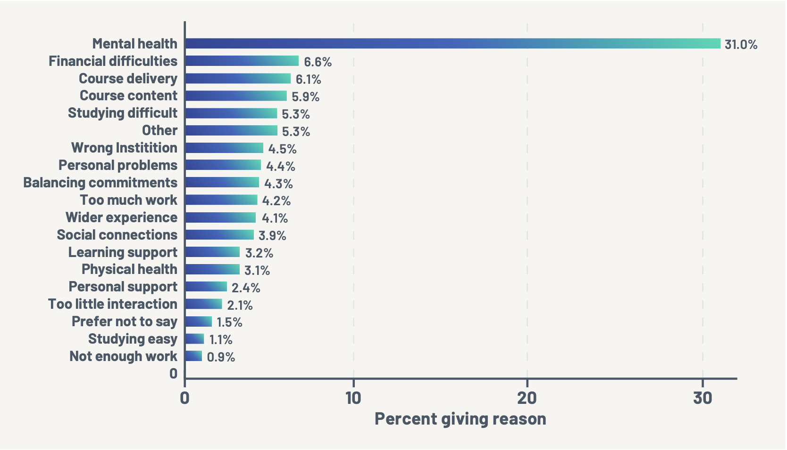
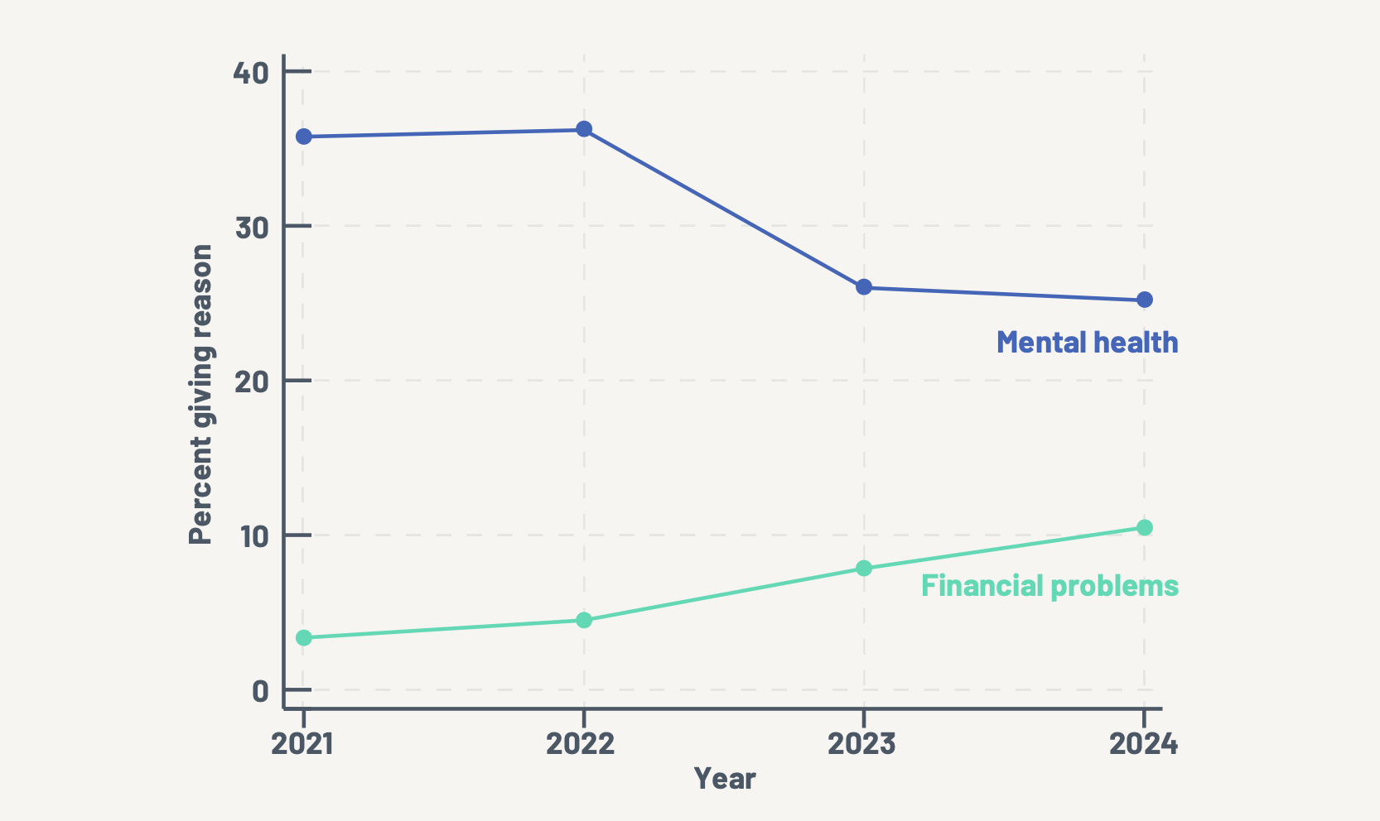
Drop Out and Mental Health
Notes:
The left summarises percentages across the last 4 waves, while the right shows the top two reasons and their changes over time.

Slide 18
Alongside these graphs
These graphs are giving us a poor, and worsening, picture, with fairly high resolution.
They also shine a light on the need for more and better support for students.
This has to be placed into the context of;
Diminishing volunteer hours post pandemic (across the board)
A lack of effectiveness of light touch interventions to improve student wellbeing (Stockdale and Sanders, 2023).
A financial position that is foreboding.

Slide 19
Foreboding
The increase in top-up fees by the pandemic brought a greater focus on widening participation and (to a lesser extent) on student success.
The US picture is very bleak - WP doesn’t lead to success. We have avoided this here so far.
The freezing of fees has also meant the freezing of resources available for these goals. The recent unfreezing will have at best a marginal effect.
Match this with increasing need, and it suggests a growing gap between supply and demand.

Slide 20
Foreboding (2)
The fall in international, postgraduate taught students has plunged the sector into financial distress and budget shortfalls
This has immediate financial consequences for institutions, and has the effect of reducing the amount of resources available for things that universities might view as non-essential, nice-to-haves.
Smart money, especially at selective institutions, is on a pivot to UG and WP.
Geopolitics will widen the gap further, even without having direct effects.

Slide 21
What can we do about it?
(Some bias)
Working smarter and together on support for our students.
Recognise that our learner analytics may lack resolution - and so we need to reach people where they are, and rely on a more human centred approach.
Concentrate our resources on student success, and on addressing the causes of mental ill health or low wellbeing among students.

Slide 22
Any questions?
michael.t.sanders@kcl.ac.uk, @mike_t_sanders
julia.ellingwood@kcl.ac.uk

Slide 23
Archive

Slide 24
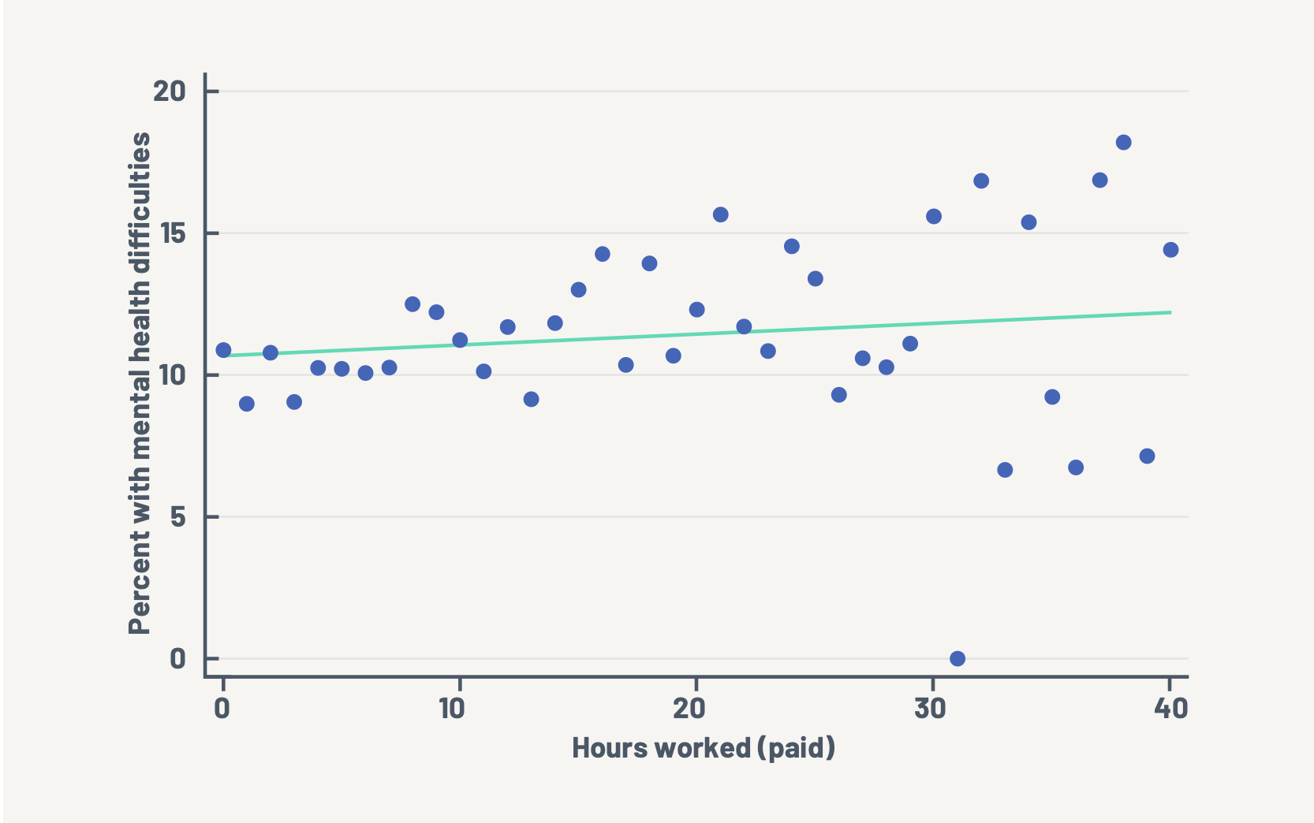
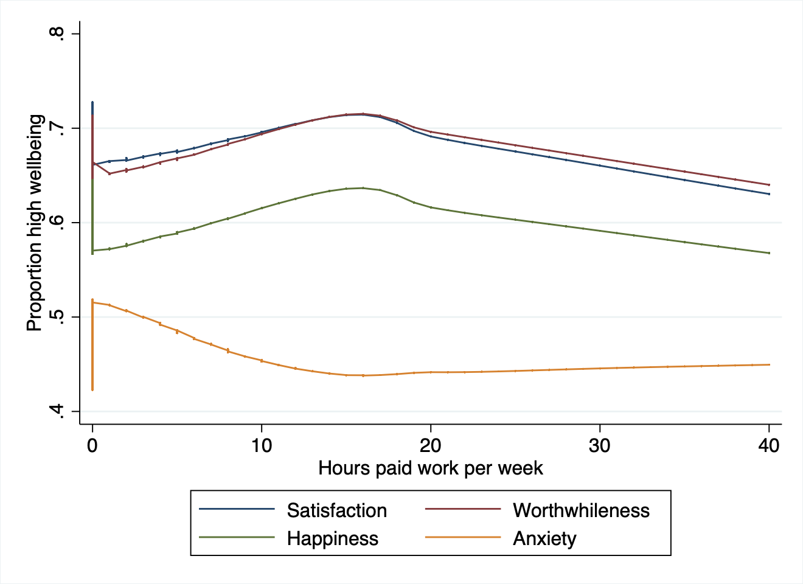
Work

