Slide 1
Evaluation Webinar
(Step 1: Diagnose)

Slide 2
Outline of session
1
Introduction to TASO
2
The Evaluation Cycle: Diagnose Stage
3
How a Theory of Change can help you
4
Developing your own Theory of Change
5
Next Steps: using your Theory of Change to devise measures of success
Notes:
Thank you for attending.
We will briefly introduce ourselves and TASO
Provide an overview of what the ToC framework offers and why we encourage stakeholders in HE to use it
Before talking you through the design process. We hereby will explain each element and will then split attendees into individual breakout rooms to discus these elements. Either in the context of the ToC that we provide (A summer school initiative) or your own initiative. As mentioned in the preparatory email, we recommend that you have the template of the ToC framework in front of you and work through this as we go along.
Lastly, once we’ve devised the Theory of how to achieve your desired change via a designated programme we will briefly touch upon outcome measures. Even though this is the focus of our second webinar, so will only be introduced on a very superficial level.

Slide 3




Who we are
Independent hub for higher education professionals to access research, toolkits, evaluation techniques and more to help widen participation and improve equality within the sector.
Set up by a consortium of King’s College London, Nottingham Trent University and the Behavioural Insights Team.
An affiliate What Works Centre, and part of the UK Government’s What Works Movement.
Funded by the Office for Students from 2019 to 2022.

Slide 4
How this can help you
Notes:
This webinar will guide you through the process of evaluating your schemes and services and outlines TASO’s recommendations for monitoring and evaluation activity.
We guide you through the development of your Theory of Change model, which is essential for all interventions as it sets out the intended outcomes of the project and how resources and activities will lead to those outcomes.
It is the first of three webinars that will talk you through our evaluation cycle

Slide 5
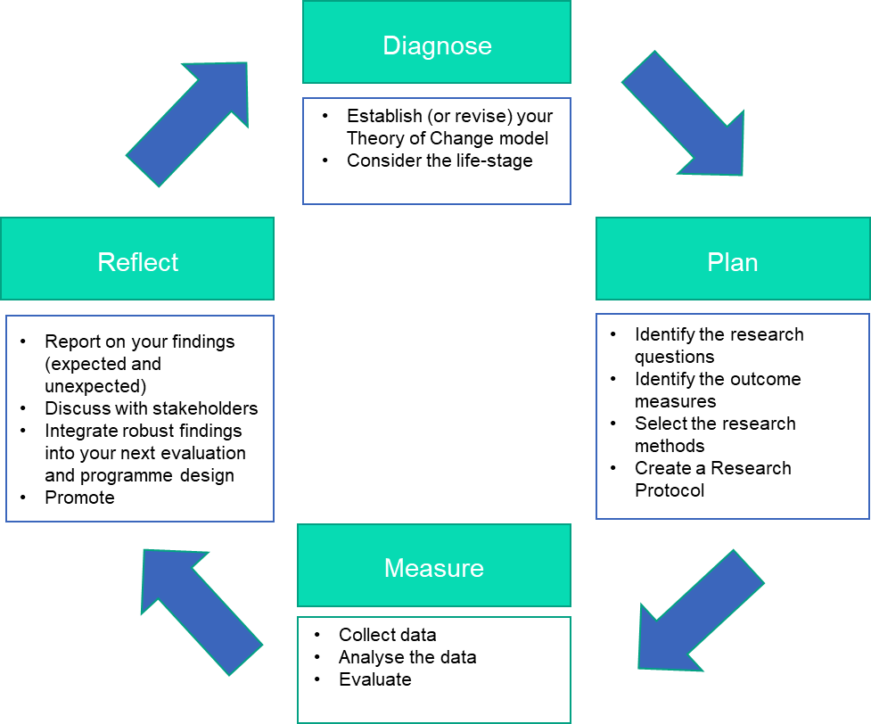
The evaluation cycle
Notes:
We are often asked when initiative owners should evaluate:
Although evaluation is generally more effective and credible when it is built in from the beginning (otherwise, thereis sometimes a risk that the data collected is not completely appropriate for the objectives which are set)
but evaluations can also be retroactively applied to existing or completed initiatives.
An effective evaluation is not an event that occurs at the end of an initiative, but an ongoing process
at TASO we consider evaluation to be reiterative. s the circular design indicates, this is an iterative process that supports continuous improvement - the findings of your evaluation (in ‘Measure’) should feed into the refinement of your Theory of Change, research questions and research methods (in ‘Reflect’).
This way findings become more robust and, ideally, over time you can generalise your findings to the wider programme impact.
Crucially, your evaluative findings should be seen as just one strand of a multi-faceted approach to mobilising knowledge. Your findings at the last step of the evaluation should thus be seen as the foundation for further activities, rather than the end-product itself.
Focus on step 1 of that circle today; how to develop a ToC
Today, in our first webinar we will focus on the diagnose stage – i.e. how to use a ToC model to understand the evaluative narrative of your initative.

Slide 6
What is a Theory of Change?
A tool that can help you
describe the need you are trying to address
the changes you want to make (your outcomes); and
what you plan to do (your activities)
It can help you improve your strategy, measurement, communication and partnership working.
Inputs
Activities
Outcomes
Impact
Notes:
A key tool to help plan for an effective evaluation is a Theory of Change (also known as “ToC”).
A Theory of Change is not a specific theory of how to plan an initiative. It won’t tell you whether your ideas are good or bad.
Instead it is a tool enables you to plan your initiative step by step, helping you to identify possible pit falls early and be prepared for the complex process of achieving
1)It hereby helps initiative owners to identify and succinctly describe the context and needs of a programme and how that specific programme design is going to address this.
WP initiatives are highly context-specific and a ToC offers a harmonised approach to accommodate that contextual relevance)
2)As mentioned, social change is complex and it is easy to feel overwhelmed by the variety of factors to consider:
so a ToC can assist with that by offering a structured process of questioning your ideas and assumptions, and developing your own personalised theory of what will change when you put your ideas into practice.
3)And once you’ve clearly identified your needs and desired changes. it then allows you to design and conceptualise your activities in a way that maximises and optimises their deliveries to achieve the desired outcomes. I.e. to identify in the planning stages the change you want to achieve and how you will measure that change.
It is therefore a versatile tool that can be of use for all your programme stakeholders:
It improves your strategy as it clearly outlines the wider, long-term impacts your programmes are aiming to achieve
It facilitates the communication with all your stakeholders (may it be local partner schools, other staff in the university, or the OfS regulator)
It helps to improve working with your programme partners, as it increases buy-in and accountability in a clear and programme-realistc way.

Slide 7
Questions a ToC can help with
A programme seems too complex to measure
A programme is too small to show any actual impact
For the scale-up of a pilot project
It takes too long
Evaluation feels like a box-ticking exercise
Notes:
ToCs have been designed to help organisations who develop social change to create and articulate an effective plan of change.
Within the WP and HE evaluation sphere a ToC help with a variety of purposes:
A lot of projects, after a pilot year with a small number of participants, have an appetite to scale up and increase the original impact of their small-scale pilot. A ToC can help with scaling up the relevant areas whilst still keeping realistic outcome measures (i.e. if you have bigger numbers, what support can you offer and how will that impact your outcomes. Likewise, if you have more resources you can makes sure that these additional resources are better allocated to achieve maximum impact in your ToC
The issue around finding appropriate outcome measures for the social change you are trying to achieve is another re-occurring obstacle: So again, a ToC can help de-complexify the link between impact and activities. once you have established the change you wish to achieve you can work backwards to plan appropriate activities, and articulate what data is available to you to evidence the desired impact.
There are also often issues around N being too small to show reliable impact and/or initiatives within WP, often being to complex and influenced by too many latent variables, to be evaluated robustly. And for a RCT, i.e. the method of causal impact that TASO promotes, this might be true but this doesn’t mean that ToCs cannot help with building an evaluation strategy that supports other forms of equally valuable and insightful evaluations, such as case studies or formative evaluations. Having said, all of TASO’s RCTs have a theory of change, which is worked through with the project and evaluation
- Often, evaluation is perceived to not be a good use of staff time. And in my work with WP teams, it was sometimes forgotten because there were more urgent priorities for the delivery team than to compile a lit review to strengthen their assumptions of why they programme works. And that is absolutely true, when a WP officer is holding an event they should not be pre-occupied with thinking about an evaluation strategy. That’s why a ToC is useful to have. It can clarify the programme impacts before the demands of delivery take over and save a lot of time (and stress) when a programme in running because thanks to the ToC everybody knows what they are doing, when and how.
Lastly, monitoring and evaluation can feel rather futile if indicators and evaluation theories do not match the actual implementation. By including different stakeholders of the programme in your ToC you can make sure that findings are meaningful and relevant for everyone involved.
essential in APP
Claim how/whether it works (and for whom)
Intervention appropriateness (too little cannot evaluate)

Slide 8
Developing a Theory of Change
Notes:
sometimes it can be difficult to envision how to achieve big-scale, long-term, ambitious change.
And I’ve been in a lot of meetings, let’s say we need an initiatve that decreases the BAME attainment gap in our medical school or close the gap of Qunitle 1 POLAR students in a central London uni…
These elephant tasks seem dauntily impossible and overwhelming.
A Theory of Change can help to break down this potentially overwhelming task into realistic, measurable and logical components. We’ve created the following example to help you visualize the process of designing a Theory of Change.

Slide 9
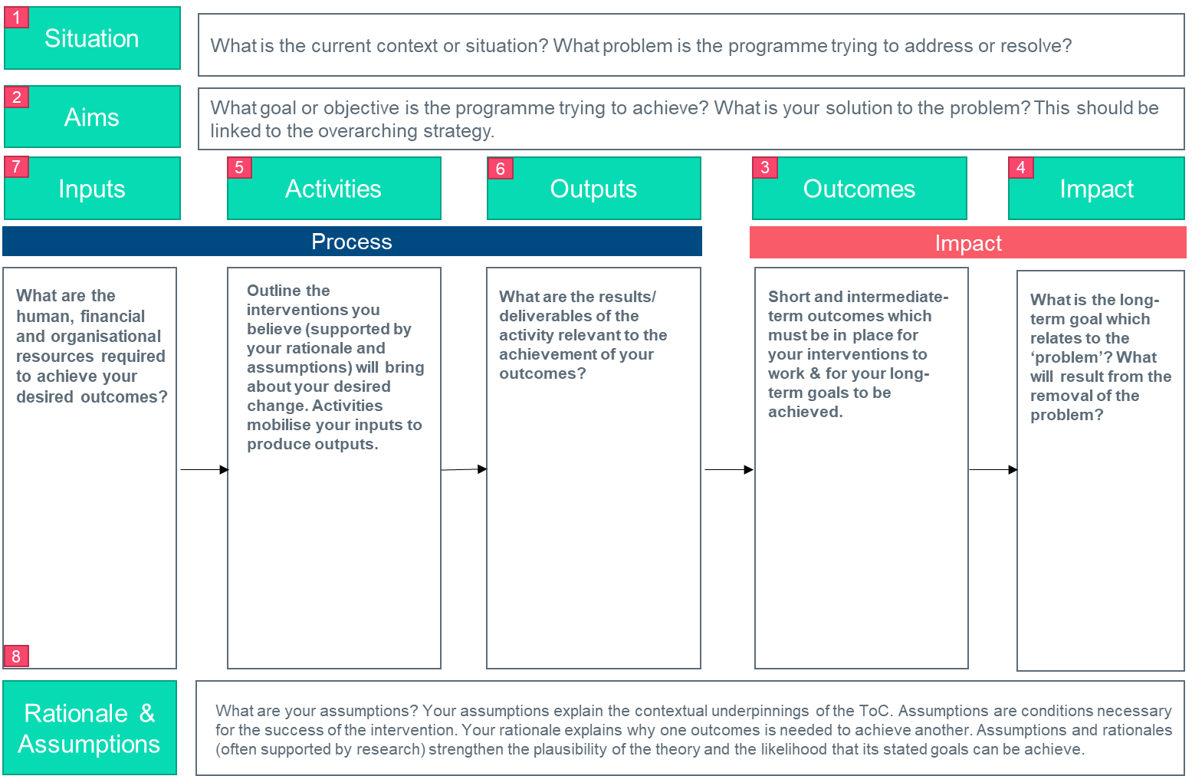
Developing a Theory of Change
Notes:
This is TASO’s suggested format for your ToC work. This isn’t set in stone and there are a few varieties of this and related models out there but for simplicity purposes (and because in my experience this format works for 95% of all programmes I’ve worked on) we will apply this model to our webinar training session.
If you are familiar with ToC models you will recognise the different elements of our model.
However, what differs from some of the models that you may have seen is the order in which we work through these elements of change. Jump quickly to the impact-side (step 4-3) and then work backwards.
Designing your Theory of Change should be like a journey from long-term impacts to inputs, which follows a logical structure. You should design your Theory of Change with an impact-focussed approach; once you have established the change you wish to achieve – and crucially, how you plan to measure that – you can work backwards to plan appropriate activities, and articulate what resources are required for delivery.

Slide 10

Theory of Change
Situation
Many students feel under-prepared for higher education, and this may contribute to a feeling of alienation when they arrive on campus. Under-represented groups often have few networks to get an informed understanding of university-style teaching and/or university communities and often have a gap in knowledge around application procedures and requirements as well as the potential financial and pastoral support available.​
Aim
To equip students with the knowledge and insight to make high-quality applications to HEPs and to debunk the myth of higher education as an elite environment towards a perspective where underrepresented students feel like they belong.​
Task
Familiarise yourself with the ToC template and work through the different elements as we go along.
Questions?

Slide 11
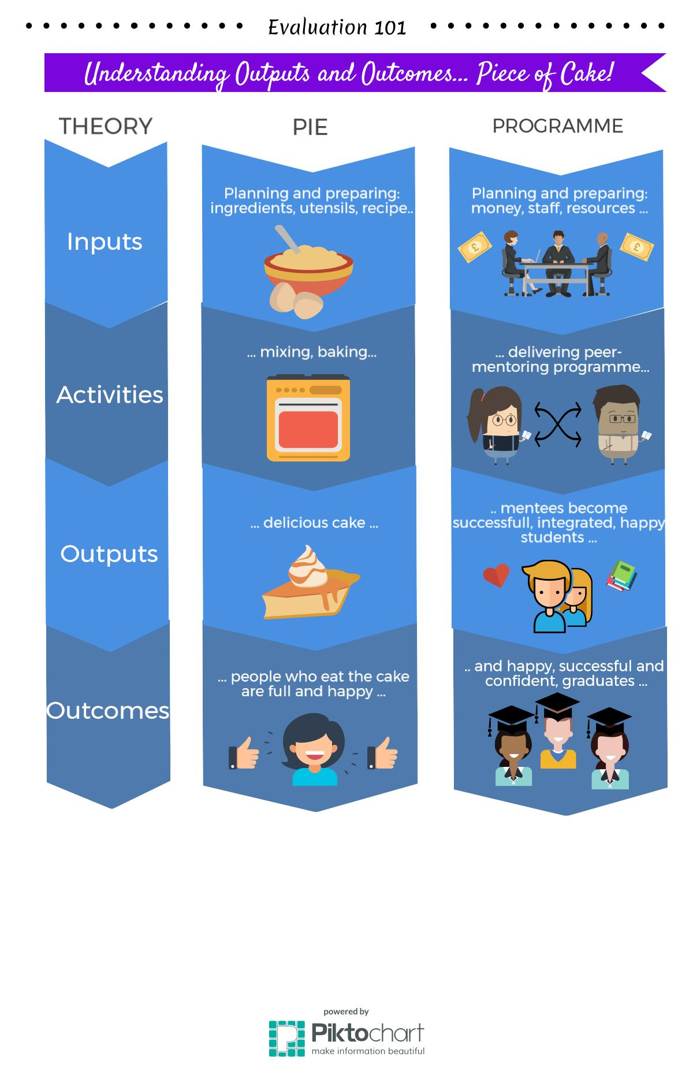
Theory of Change
Outputs vs Outcomes
Notes:
From my experience in WP, some people struggle to distinguish between outputs and outcomes. And when developing theories of change the two are sometimes used interchangeably even though they are significantly different.
To get the context right, let’s start with a simple, non-HE related example. Imagine it is my nephew’s 6th birthday. You go to the local bakery and order a dinosaur-themed cake for the morning of the party.
If I ask a group of people about the outcome of this transaction, most people will answer that the outcome is the birthday cake.
That is not correct. The outcome of this will be a delighted birthday boy and a group of happy, cake-filled 6-year-olds.
The cake itself is the output, provided by the bakery.
If the cake had not been tasty, or if the bakery had delivered a fairy-themed cake instead of the desired dinosaurs, then the desired outcome—happy kids—would, in all probability, not have been achieved.

Slide 12
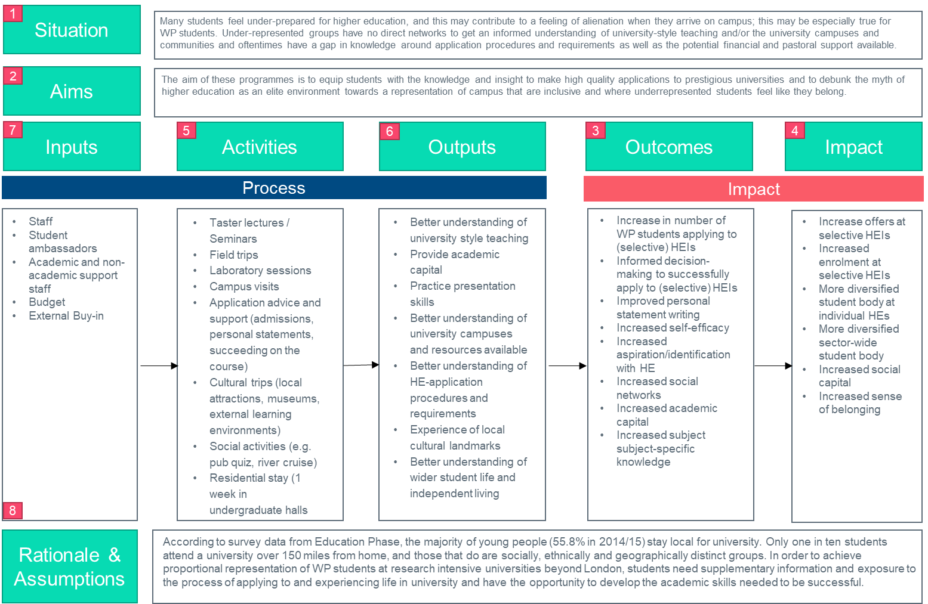
Theory of Change: Outcomes
Notes:
So, starting with the outcomes. We will now offer your 2 minutes to think through your own project and what the outcomes (Short and intermediate-term outcomes which must be in place for your interventions to work & for your long-term goals to be achieved).

Slide 13
Theory of Change: Outcomes
Notes:
How to we break the task of inclusive, welcoming campuses and well-informed applicants together?
Thinking about the medium-term goals of students participating in the summer school, we assume that the increased understanding of how to apply to uni might increase application numbers (maybe particularly for the more selective HEPs)/
Due to increased knowledge on their subject of choice (i.e. medicine for a medical degree), how to write an persona statement, their and other app criteria, we also think that a higher number of these are succesfull applications
We hope that participants, having seen the campuses and communities, and have increased their social networks by meeting and connecting with positive role models but also academic and other HE staff.
Situating this, will become obvious when we work through these slides but what you can see here: None of these are guaranteed deliverables but also we are not adressing the long-term goals of what we hope will change in the wider area beyond the progamme yet. W will do that in our next steps-> Impacts

Slide 14
Theory of Change
Impacts
Notes:
The outputs will happen as a direct result of your activity, your specified outcomes could happen, and your impact is what you hope to happen. Whilst you are in direct control of your outputs – providing your activities are delivered as planned – external factors can compromise your longer term outcomes and impacts.
Following the outcomes, think about long-term goals relating to your situation and aims and think about the results that will come from removing the situation/problem you are trying to address.
We’ve got some examples of potential impacts listed here. Think about long-term goals that you’re initiative seeks to address. Be ambitious but realistic here and consider the life-stage of your programme (i.e. how much do you already know about how your programme works) when doing so.

Slide 15
Theory of Change: Impacts
Outcomes
Notes:
What is the long-term goal which relates to the ‘problem’? What will result from the removal of the problem?
And also, considering the outcomes we’ve just defined in our previous step, think what logically flows from these in the long-term.

Slide 16
Theory of Change: Impacts
Outcomes

Slide 17



Theory of Change
Activities + outputs
Activities
Outputs
Actions or activities designed to achieve particular outputs and outcomes
Initiatives follow outcomes (not vice versa).
Completely in your control as these are direct deliverables that will follow when you deliver your initiative as planned
What WILL happen rather than what COULD happen
Notes:
The next element we’re focusing on are activities and outputs.
As mentioned before, outputs are direct deliverables from your activities so will happen rather than could happen as they are in your direct control.
So keep that in mind, when buying the birthday cake, the cake is an ouput not an outcome. However, again, think about the outcomes we’ve identified to think about what outputs we need to have in place to make them happen – i.e. initiatives follow Outcomes (not vice versa).
So then think about actions or activities designed to achieve particular outputs

Slide 18
Theory of Change: Activities + Outputs
Outcomes

Slide 19
Theory of Change: Activities + Outputs
Outcomes

Slide 20


Theory of Change
Inputs
Intangible
Buy-in
Subject knowledge
Reputation
Tangible
Staff
Budget
Venue
Etc.
Operational
Promotional Material
Time
Notes:
Inputs are tangible and intangible resources which are required to to carry out your activities
When thinking about your inputs, think about what you will need to invest in the initiative (e.g. time, people, funds, etc.)

Slide 21
Theory of Change: Inputs
Outcomes

Slide 22
Theory of Change: Inputs
Outcomes

Slide 23
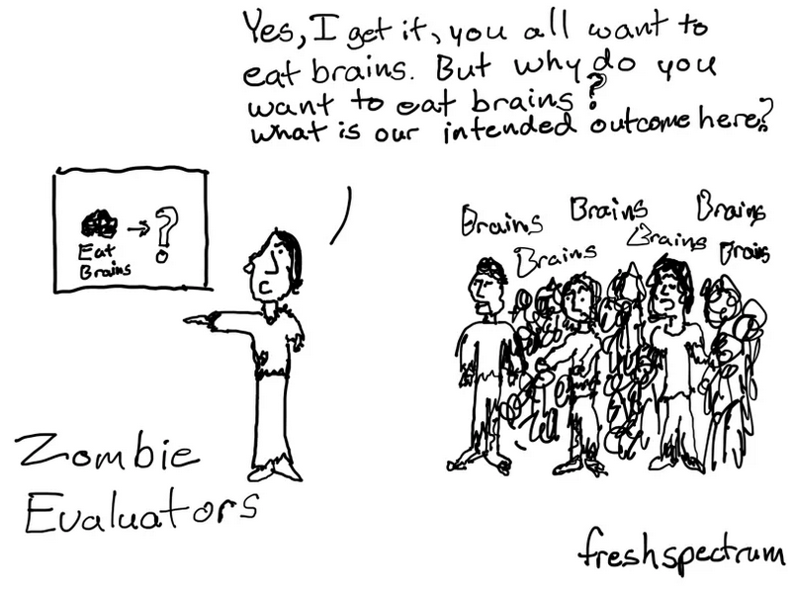
Theory of Change
Rationale + Assumptions
Notes:
At the point of designing the initiative, decisions should be underpinned by evidence to show that the intended effect it is anticipated to have is realistic and feasible.
For our summer school, we referred to the EPI evidence synthesis and the evidence collected to demonstrate the links in the theory of change.
If there is no evidence in your focus of change, new evidence can be generated by building in evaluation into the design of the initiative.
in general, when working through this element of your ToC:
Revisit all the assumptions you’ve made and the rationale behind them.
For example:
Are you sure that A leads to B?
And are you sure that this is the direction of travel for your desired impact?

Slide 24
Theory of Change: Rationale + Assumptions
Outcomes

Slide 25
Theory of Change: Rationale + Assumptions
Outcomes
Notes:
For the complex interventions we design in widening participation, it’s even useful for bringing all the threads together.
A Theory of Change should help you plan effectively, mitigate risks, uncover assumptions and spot possible issues in the early stage of project design. Most importantly, however, in the event of a negative or inconclusive result, a good Theory of Change provides you with the tools to distinguish why this was the case.
A well-designed Theory of Change will help the evaluator in distinguishing between theory fallacy (the underlying assumptions are not leading to the intended outcomes), implementation fallacy (the intervention was not implemented as intended) or methodology fallacy (unsuitable evaluation methods were used or suitable methods were used insufficiently).

Slide 26
How to measure if your Theory of Change is working
Notes:
Obviously, the work doesn’t just stop with a clear and lofgical theory of how to achieve the change
So outcome measures, how you operationalise your theory, is just as important for your theory of change to whether the outputs , outcomes and impacts of your initiative are actually testable
This will be the focus of our next webinar, as this requires a bit more time than the 60 mins available to us, but we briefly want to touch upon this in the next slides.

Slide 27


Outcome measures
“I’ll know [outcome reached] when I see [indicator]”
Observable indicators are those we can build into the evaluation and control out; e.g. demography, observed behaviour, measured attitudes.
  Unobservable indicators are those we can’t observe and therefore can’t build into the evaluative model; e.g. motivation, unobserved behaviour, unmeasured attitudes; anything that influences the outcome that we don’t know about or can’t measure.
Notes:
So now we have our THEORY of change, we now need to know how to measure this to robustly show whether we’re actually achieving this.
For this we need to decide what the best outcome measure or indicator. Indicator are things we can tangibly measure (they don’t need to be perfectly matching your outcome concept but they need to be valid enough to give us a good proxy).
Some are observable indicators, i.e. clearly identifiable information that we can easily built into an evaluation because we can measure it (demographic info like age but also observed behaviour like engagement)
But some are unobservable indicators, which we cannot easibly measure and build into the evaluation as we don’t have indicators thor this (unobserved behaviour, for example discussion of HE and HE perceptions in a YP’s home or the motivation of these YP to engage due to parental engagement etc)
From my experience, finding the best proxy measure is the most difficult bit (And you shouldn’t need to do this alone. You are the experts on the programmes you are running, and we help to share our expertise on available data sources in HE to translate those ideas into measurable outcomes)
But as a guideline:
To help us all work towards a common framework we have a Common Outcome Measures table (Appendix to the MEF) which you can find overleaf

Slide 28
Common outcome measures
Year group | Objectives | Indicators for Process Evaluation | Indicators for Impact Evaluation (short-medium term) | Indicators for Impact Evaluation (long -term)
KS4 (Years 10-11) | Raising attainment Engaging parents Increasing awareness of subject options at HE | Was the programme delivered as intended? Were students targeted correctly? Did students attend? Which students attended? Was the content delivered as intended by deliverers? (academics, ambassadors etc.) Participant experience as measured by evaluation survey Experience & perceptions of stakeholders e.g. key influencers such as teachers, ambassadors, project leads, academics | GCSE attainment (through NPD) | A-level attainment (through NPD/HEAT) Progression to HE (HEAT) Progression to high-tariff HEPs (HEAT)
KS5 (Years 12-13) | Improved knowledge and confidence – academic skills, culture Increased knowledge of how to apply to HE Enhance attainment Increase preparedness for study in HE Mentoring (current student as e-mentor) | Was the programme delivered as intended? Were students targeted correctly? Did students attend? Which students attended? Was the content delivered as intended by deliverers? (academics, ambassadors etc.) Participant experience as measured by evaluation survey Experience & perceptions of stakeholders e.g. key influencers such as teachers, ambassadors, project leads, academics | Pre-&-post common survey questions Pre-&-post attainment tests Offers received (from home HEP) Successful offers (from home HEP) A-level attainment (through NPD) | Progression to HE (HEAT) Progression to high-tariff HEPs (HEAT) Progression to own HEP (HEAT & internal) Graduate outcomes (GOS)
Notes:
This is an excerpt of what it looks like.
There are boxes by key stage – we encourage you to use these measures as they are available
For some programmes that are unique to your HEIs (parent power at KCL) you may need to create indicators outside of those provided.
- For these you will need to consider how reliable and valid your indicators are.
more information about this can be found in the MEF and our next webinar can support you in this process.
Key though is choosing the most reliable and valid indicator that you have. So questionnaires and scales previously verified by academics will be better than ones we create ourselves. Indicators where we don’t need the participant to give a subjective answer are better than questions where people need to self report.

Slide 29

Evaluation guidance
New guidance on our website:
  Diagnose
  Plan
  Measure
  Reflect
Upcoming webinars

Slide 30

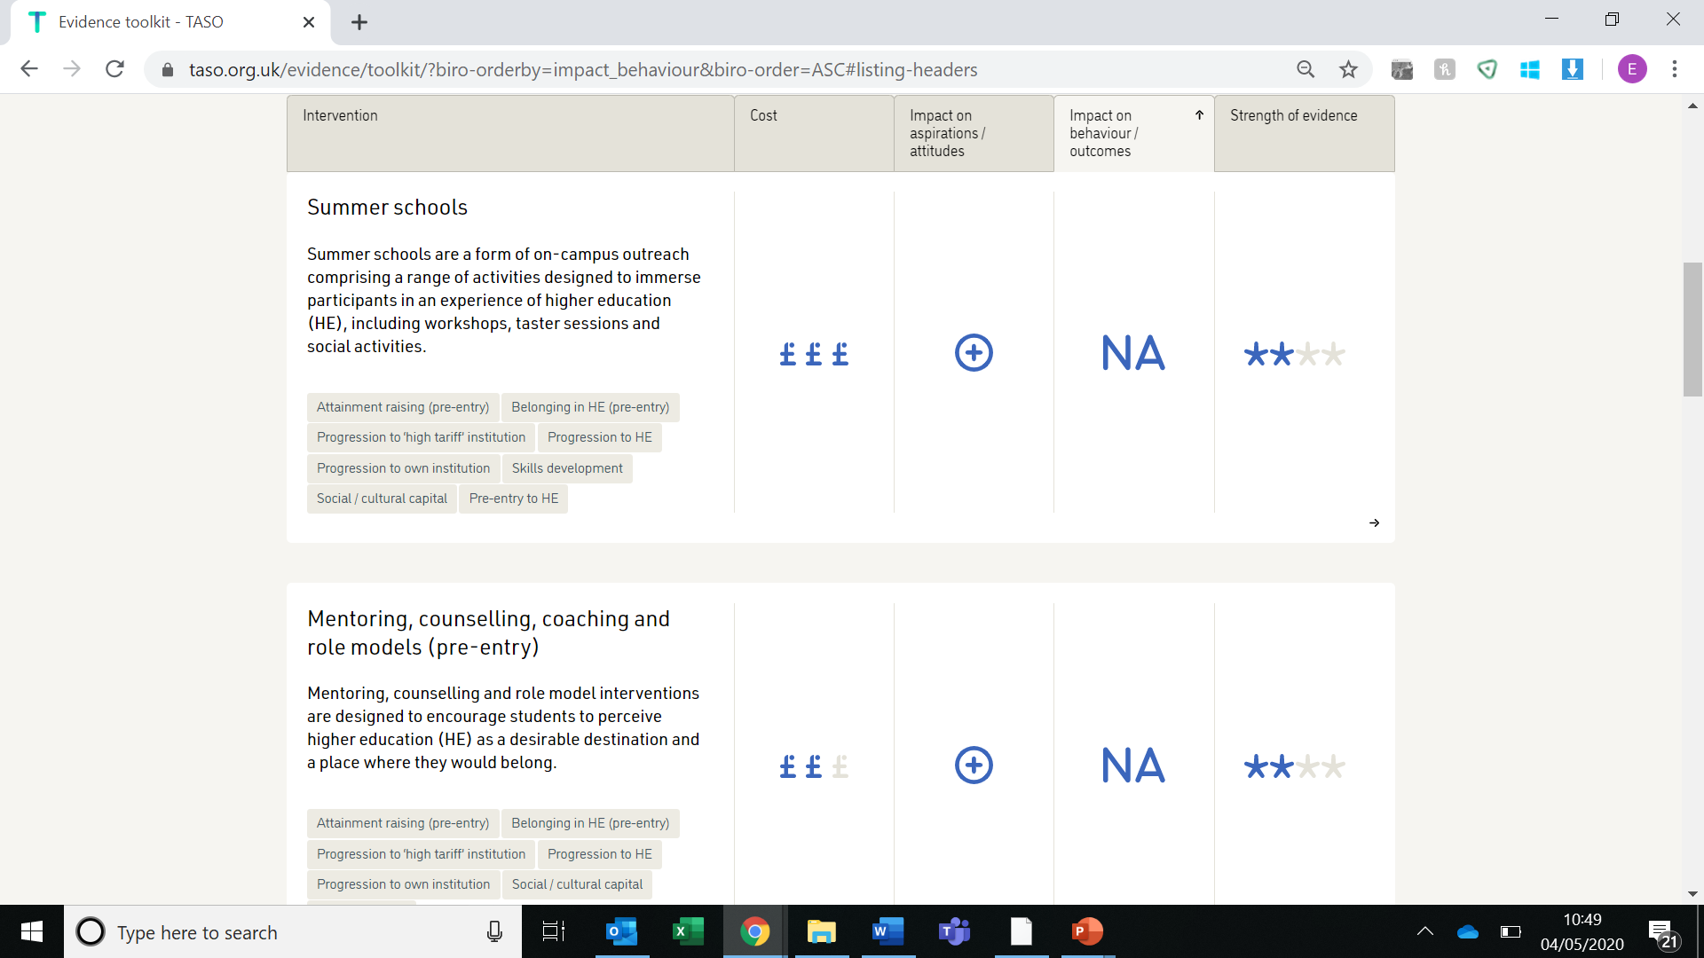
Evidence toolkit
Evidence toolkit
taso.org.uk

Slide 31
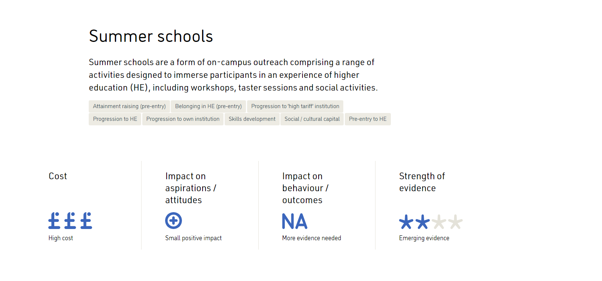
Evidence toolkit
Evidence toolkit
taso.org.uk

Slide 32
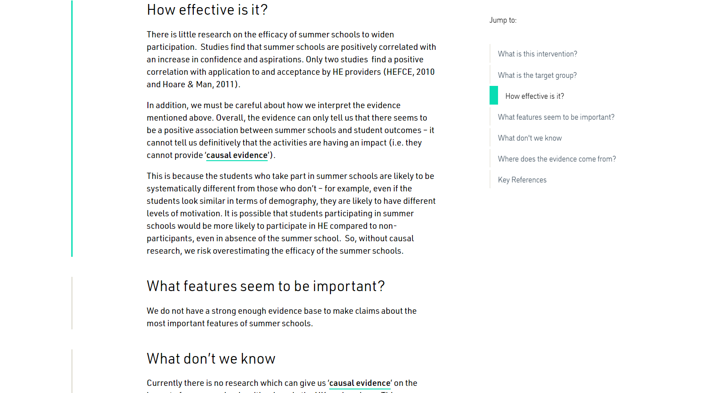
Evidence toolkit
Evidence toolkit
taso.org.uk

Slide 33

Questions?

